Slide 1




AT82.02
Data Modeling and Management
Lab9: Data Engineering

Slide 2
Outline
Extract Transform Load (ETL)
Talend Open Studio for Integration
Tutorial: Movie Rating Prediction
Part 1 - Extract
Part 2 – Transform & Load

Slide 3
Extract Transform Load
Extract is the process of reading data from a database. In this stage, the data is collected, often from multiple and different types of sources.
Transform is the process of converting the extracted data from its previous form into the form it needs to be in.
Load is the process of writing the data into the target database.
Notes:
Extract is the process of reading data from a database. In this stage, the data is collected, often from multiple and different types of sources.
Transform is the process of converting the extracted data from its previous form into the form it needs to be in so that it can be placed into another database. Transformation occurs by using rules or lookup tables or by combining the data with other data.
— improving data quality and compliance. ETL yields transformed data through these methods: Cleaning, Filtering, Joining, Sorting, Splitting, Deduplication, Summarization
Load is the process of writing the data into the target database.

Slide 4

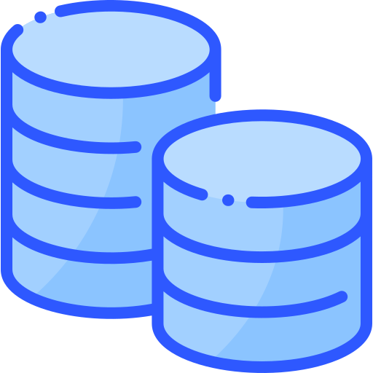


ETL Process
Extract
Transform
Load
Cleaning
Filtering
Joining
Spliting
…
Image source: https://www.flaticon.com
Notes:
Icons made by <a href="https://www.flaticon.com/authors/freepik" title="Freepik">Freepik</a> from <a href="https://www.flaticon.com/" title="Flaticon"> www.flaticon.com</a>

Slide 5
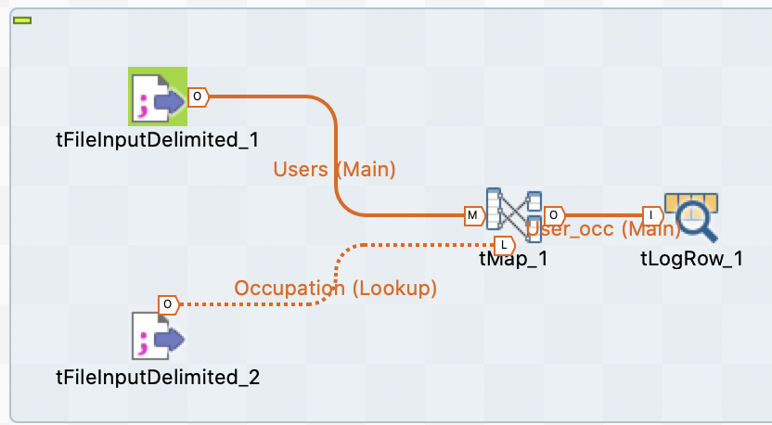
Talend Open Studio for Data Integration
Talend Open Studio is a free open source ETL tool for Data Integration
Provide Drag and Drop components and connect them to create and run ETL Jobs.
The tool will create the Java code for the job automatically
There are multiple options to connect with Data Sources such as RDBMS, Excel, SaaS Big Data ecosystem
Notes:
Talend Open Studio is a free open source ETL tool for Data Integration and Big Data. It is an Eclipse based developer tool and job designer. You just need to Drag and Drop components and connect them to create and run ETL or ETL Jobs. The tool will create the Java code for the job automatically and you need not write a single line of code.
Data Integration – connect data from a range of sources into a clean, complete, and uncompromised source of truth
Pipeline designer – design, deploy and reuse data pipeline

Slide 6
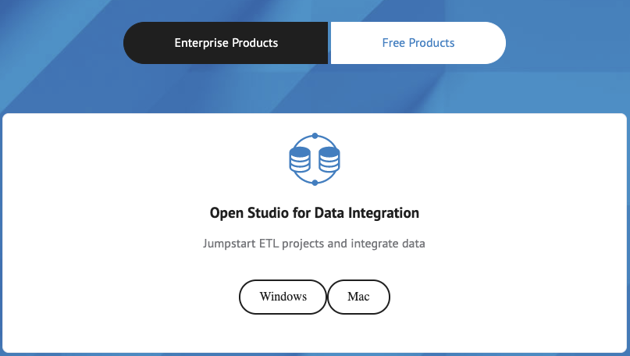
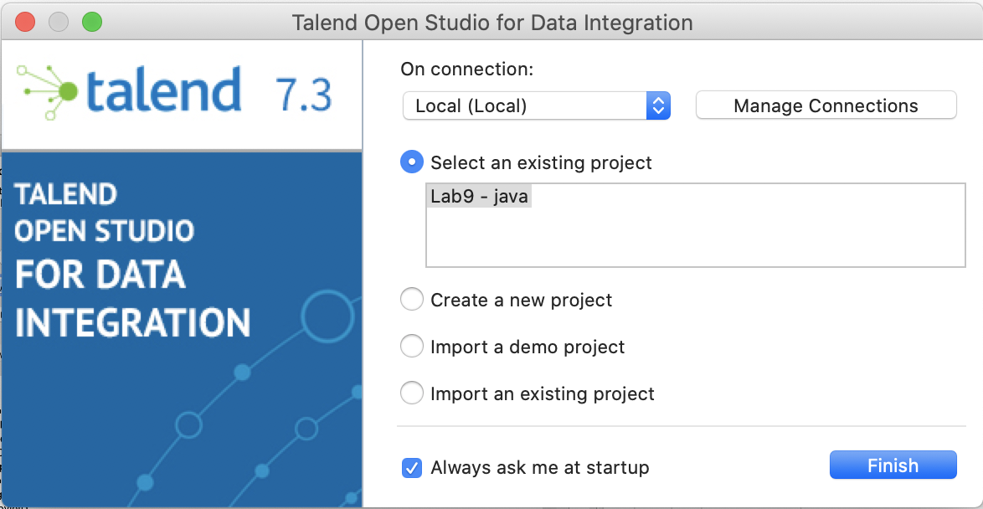
Talend Installation
Open Studio for Data Integration
https://www.talend.com/products/data-integration/data-integration-open-studio/
Cloud Integration (Free Trial):
https://www.talend.com/free-trial/
Notes:
https://www.talend.com/products/big-data/big-data-open-studio/

Slide 7
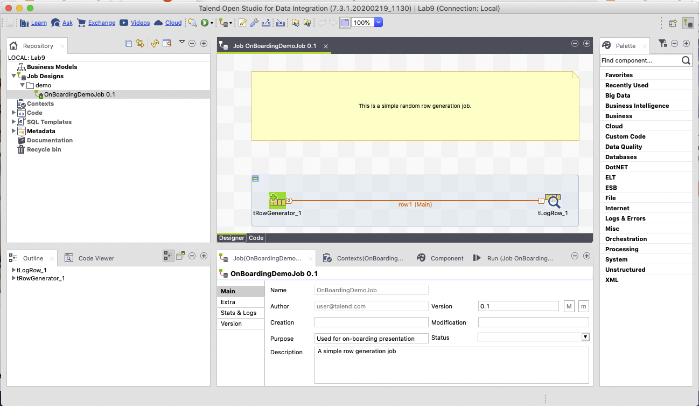
Repository
Design Workspace
Configuration Tab
Palette

Slide 8
Components for Data Integration
No | Component | Description
1 | tMysqlConnection | Connects to MySQL database defined in the component.
2 | tMysqlInput | Runs database query to read a database and extract fields (tables, views etc.) depending on the query.
3 | tMysqlOutput | Used to write, update, modify data in a MySQL database.
4 | tFileInputDelimited | Reads a delimited file row by row and divides them into separate fields and passes it to the next component.
5 | tFileInputExcel | Reads an excel file row by row and divides them into separate fields and passes it to the next component.

Slide 9
Components for Data Integration
No | Component | Description
6 | tFileList | Gets all the files and directories from a given file mask pattern.
7 | tFileArchive | Compresses a set of files or folders in to zip, gzip or tar.gz archive file.
8 | tRowGenerator | Provides an editor where you can write functions or choose expressions to generate your sample data.
9 | tMsgBox | Returns a dialog box with the message specified and an OK button.
10 | tLogRow | Monitors the data getting processed. It displays data/output in the run console
11 | tPreJob | Defines the sub jobs that will run before your actual job starts

Slide 10
Components for Data Integration
No | Component | Description
12 | tMap | Acts as a plugin in Talend studio. It takes data from one or more sources, transforms it, and then sends the transformed data to one or more destinations.
13 | tJoin | Joins 2 tables by performing inner and outer joins between the main flow and the lookup flow.
14 | tJava | Enables you to use personalized java code in the Talend program.
15 | tRunJob | Manages complex job systems by running one Talend job after another.
16 | tUniqRow | Compares entries and sorts out duplicate entries from the input flow.

Slide 11
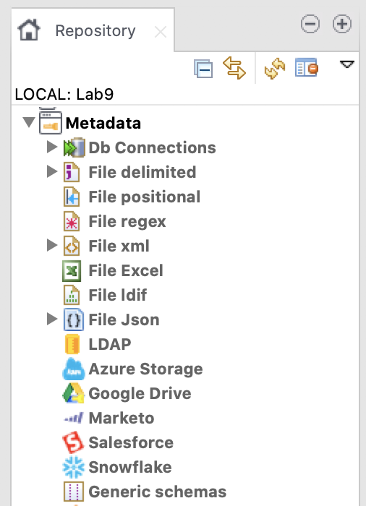
Definition
Job Design
This is the graphical representation of the business model.
In this design, one or more components are connected with each other to run a data integration process.
Example Job
Metadata
Metadata basically means data about data.
The main use of metadata in Talend Open Studio is that you can use these data sources in several jobs just by a simple drag and drop from the Metadata in repository panel.
Metadata
Notes:
This is the technical implementation/graphical representation of the business model. In this design, one or more components are connected with each other to run a data integration process. when you drag and drop components in the design pane and connect then with connectors
a job design converts everything to code and creates a complete runnable program which forms the data flow.

Slide 12
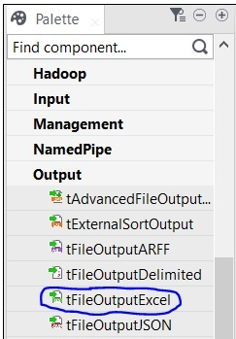
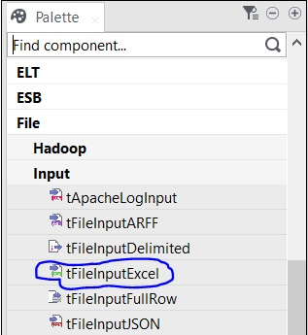
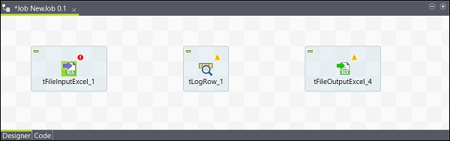
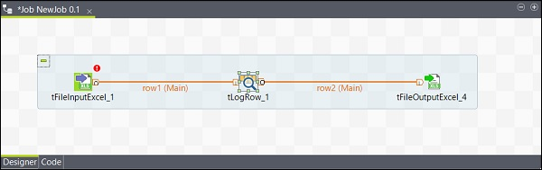
Job Design
Create a job
Adding Components to Job Design
Connecting the components
Configuring the components
Executing the Job
Adding components
Connecting components
Notes:
https://www.tutorialspoint.com/talend/talend_job_design.htm

Slide 13
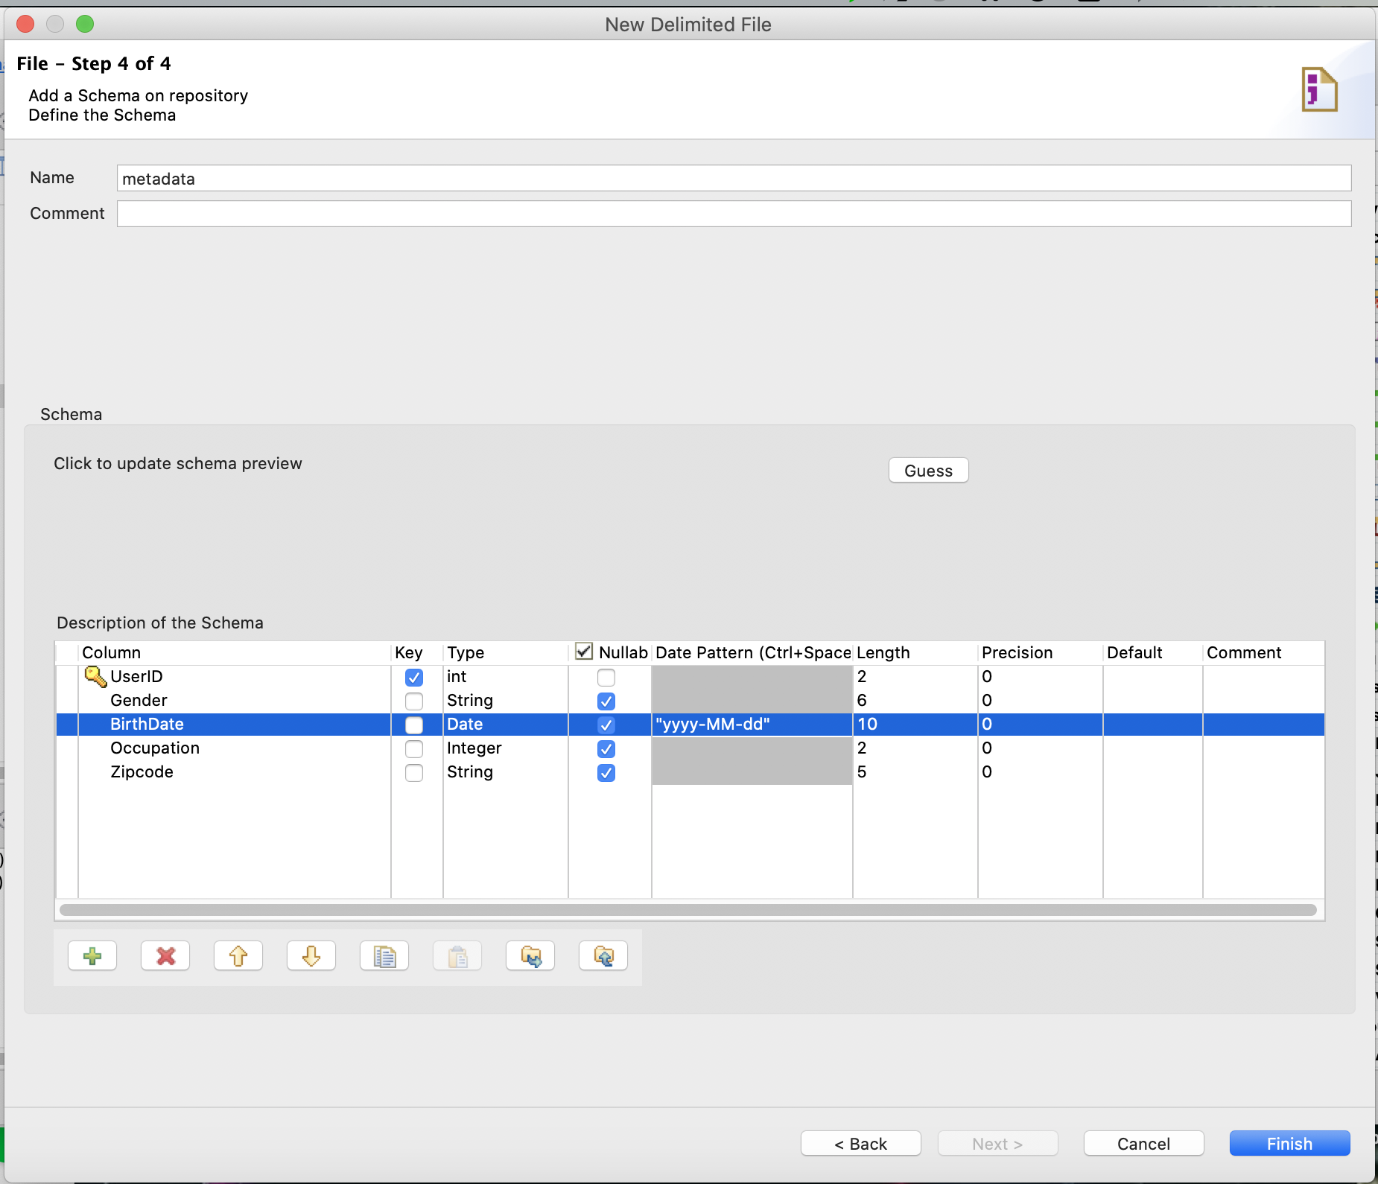
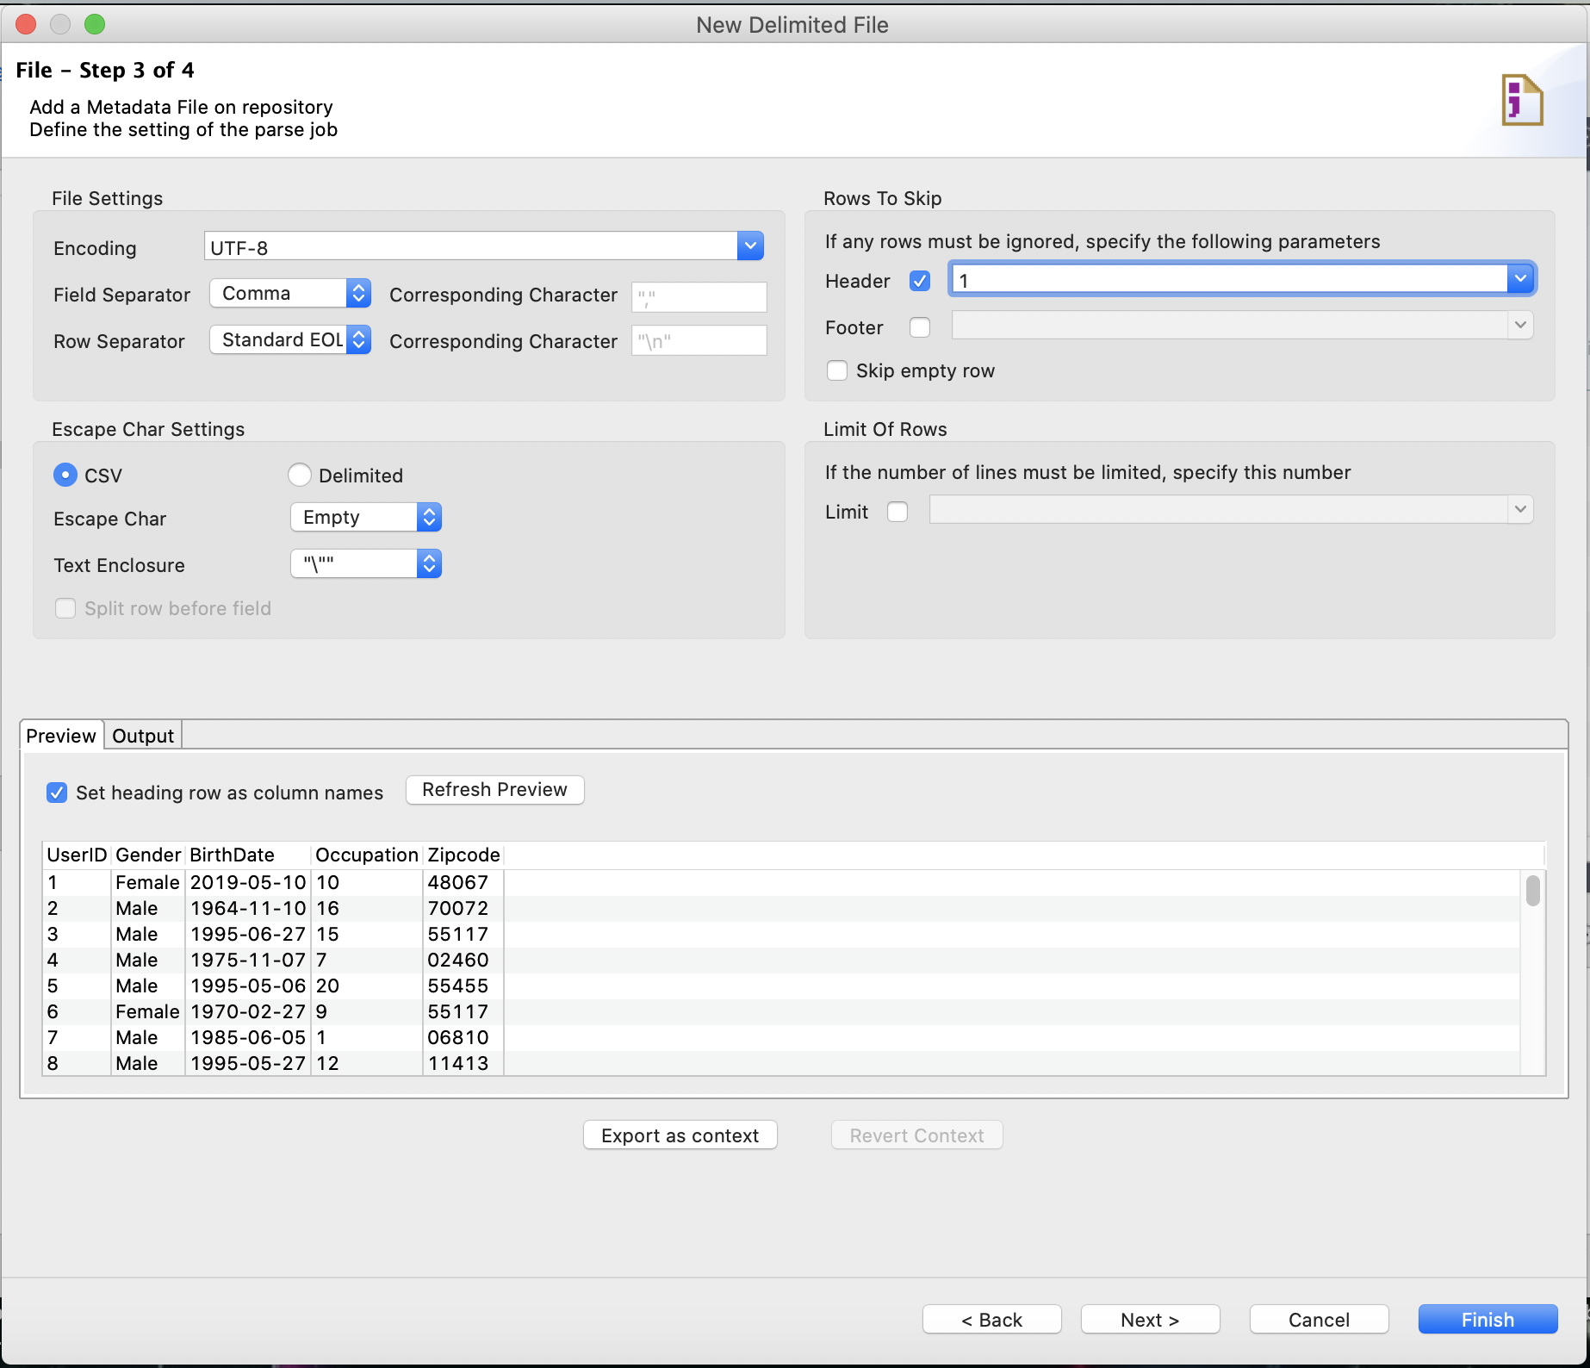
Metadata
1
3
Select type of Metadata
Set Configuration of the data
Example: File Delimited (CSV)
Encoding
Field Separator
Schema
Set Schema
2
Set configuration
Notes:
https://www.tutorialspoint.com/talend/talend_job_design.htm

Slide 14

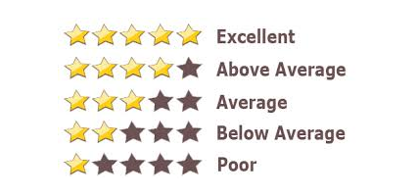
Movie Rating Prediction
Movie rating is an important element to decide movie quality.
People prefer to use rating as reference to decide before deciding to watch a movie or not.
We plan to use historical values of the movie as features (e.g. user profile, movie category, user rating) to predict movie rating before the movie released.
Notes:
https://www.kaggle.com/sherinclaudia/movie-rating-prediction
Movie prediction is an important way to predict movie revenue and performance. Through data analysis, we can find the most popular genres, performance in recent years and how it affects the reputation of the next movie. As movie production incurs huge cost and efforts, our effort is to predict the percentage of success, so that production could be managed accordingly.

Slide 15
Movie Rating Prediction
Datasets: Movies, User Profile , Movie Rating by Users
The variables used for input:
Age , Gender , Occupation, Movie Category
The variables used for model prediction:
User Rating
source: https://www.kaggle.com/sherinclaudia/movie-rating-prediction

Slide 16


Movie Rating Prediction
Input
Output
Movies
ETL Process
Prediction Model
User Profile
Movie Rating by Users
Data Visualization
Notes:
Icons made by <a href="https://www.flaticon.com/authors/freepik" title="Freepik">Freepik</a> from <a href="https://www.flaticon.com/" title="Flaticon"> www.flaticon.com</a>

Slide 17




Movie Rating Prediction
ETL Process
Output
Input
Movie
Step1: get movie data from RDB and convert data to CSV file
Step2: get user profile in CSV format
Step3: get movie rating by users from MongoDB
3.1 export data to JSON file
3.2 convert Json to CSV file
Comedy
…
Rating
movie
movie_category
Extract
1
...
2
0
..
3
Relational Database
1
..
4
User Profile
CSV for Prediction
Step.4 Prepare data for desired datasets
4.1 Transform movie category data
4.2 Remove Duplicate Records
4.3 Integrate 3 datasets
4.4 Convert birthdate to Age 4.5 Convert Gender to numeric
4.6 Filter age >= 7 and Gender = 1|2
4.7 Merge output of 4.1 and 4.6
CSV File
Transform
Movie Rating by Users
Export to json
CSV for Visualization
MongoDB
Load
Step.5 Write output CSV files

Slide 18
Movie Rating Prediction
Input
ETL Process
Talend
Step1: get movie data from RDB and convert data to CSV file
Step2: get user profile in CSV format
Step3: get movie rating by users from MongoDB
3.1 export data to JSON file
3.2 convert Json to CSV file
Task1 for step 1
- 1.1 Create Metadata for DB Connection
- 1.2 Create TJob#1
- 1.3 Create Metadata for movie
Movie
movie
movie_category
Extract
Task2 for step 2
- Create Metadata for user profile
Relational Database
User Profile
Task3 for step 3
- 3.1 Create Metadata for movie rating (Json)
- 3.2 Create TJob#2
- 3.3 Create Metadata for movie rating (File Delimited)
Step.4 Prepare data for desired datasets
4.1 Transform movie category data
4.2 Remove Duplicate Records
4.3 Integrate 3 datasets
4.4 Convert birthdate to Age 4.5 Convert Gender to numeric
4.6 Filter age >= 7 and Gender = 1|2
4.7 Merge output of 4.1 and 4.6
CSV File
Transform
Movie Rating by Users
Task4 for step 4.1
- 4.1 Create TJob#3
- 4.2 Create Metadata for movie category
Export to json
MongoDB
Task5 for step 4.2-5
- Create TJob#4
Load
Step.5 Write output CSV files

Slide 19
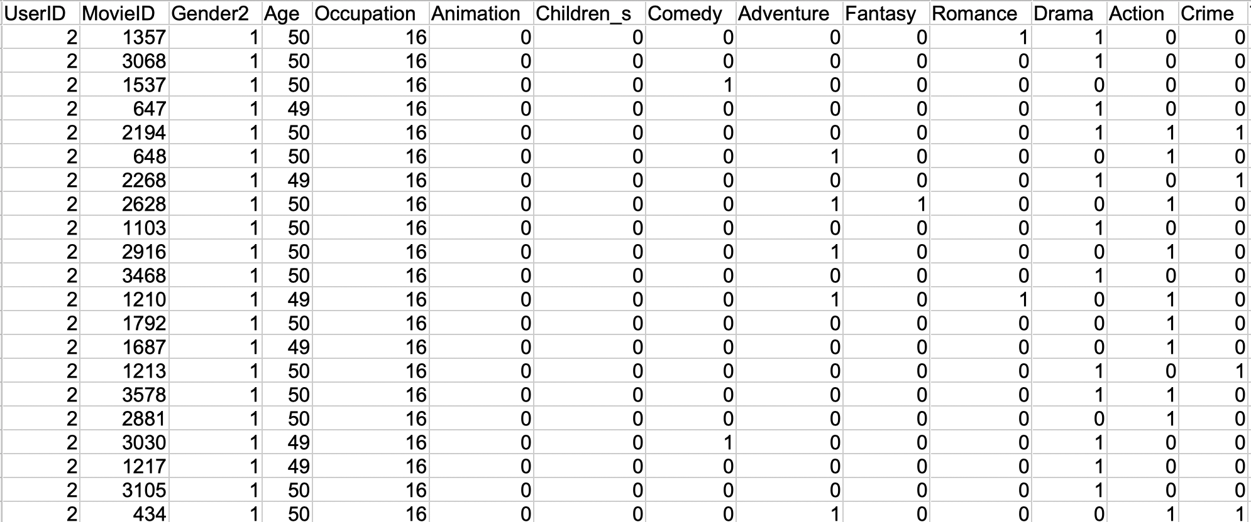
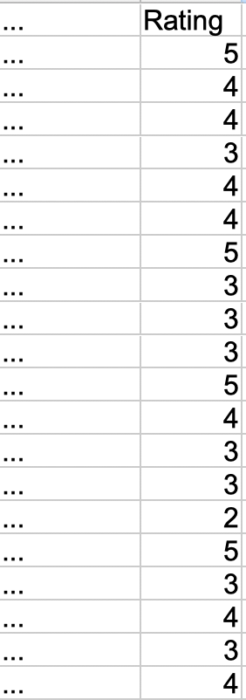
Desired Output for Prediction
Gender
Age
Occupation
Movie category
Rating

Slide 20
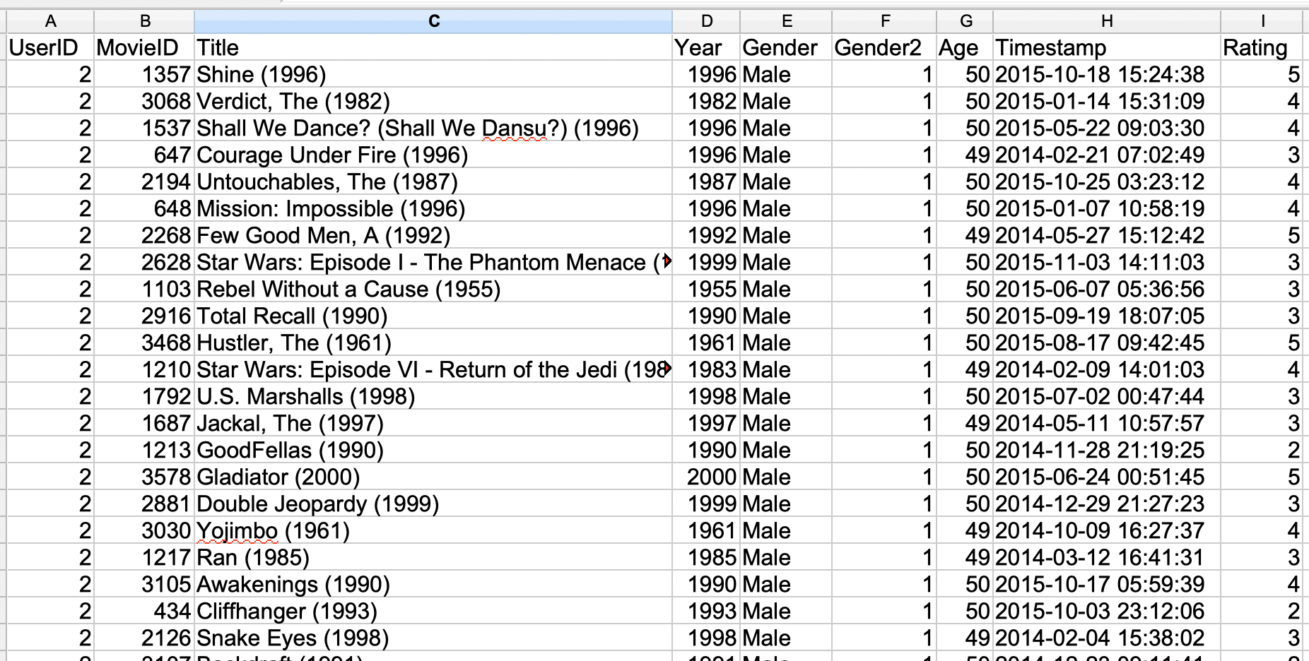
Desired Output for Visualization

Slide 21
Part 1

Slide 22
ETL Process
Extract
Transform
Load
Cleaning
Filtering
Joining
Spliting
…
Image source: https://www.flaticon.com
Notes:
Icons made by <a href="https://www.flaticon.com/authors/freepik" title="Freepik">Freepik</a> from <a href="https://www.flaticon.com/" title="Flaticon"> www.flaticon.com</a>

Slide 23
Goal of Part1
Movie
movie
movie_category
Relational Database
movies metadata
Part2
User Profile
Transform & Load Process
CSV File
users metadata
Movie Rating by Users
Export to json
ratings metadata
MongoDB

Slide 24
Movie Rating Prediction
Input
ETL Process
Talend
Step1: get movie data from RDB and convert data to CSV file
Step2: get user profile in CSV format
Step3: get movie rating by users from MongoDB
3.1 export data to JSON file
3.2 convert Json to CSV file
Task1 for step 1
- 1.1 Create Metadata for DB Connection
- 1.2 Create TJob#1
- 1.3 Create Metadata for movie
Movie
movie
movie_category
Extract
Task2 for step 2
- Create Metadata for user profile
Relational Database
User Profile
Task3 for step 3
- 3.1 Create Metadata for movie rating (Json)
- 3.2 Create TJob#2
- 3.3 Create Metadata for movie rating (File Delimited)
Step.4 Prepare data for desired datasets
4.1 Transform movie category data
4.2 Remove Duplicate Records
4.3 Integrate 3 datasets
4.4 Convert birthdate to Age 4.5 Convert Gender to numeric
4.6 Filter age >= 7 and Gender = 1|2
4.7 Merge output of 4.1 and 4.6
CSV File
Transform
Movie Rating by Users
Task4 for step 4.1
- 4.1 Create TJob#3
- 4.2 Create Metadata for movie category
Export to json
MongoDB
Task5 for step 4.2-5
- Create TJob#4
Load
Step.5 Write output CSV files

Slide 25
Task1 for step 1
Movie
movie
movie_category
Relational Database
Step1: get movie data from RDB and convert data to CSV file
Task1:
1.1 Create Metadata for DB Connection
1.2 Create TJob#1 => Convert data in MySQL to CSV file named “movie_data.csv”
1.3 Create Metadata for movie data (File Delimited)

Slide 26
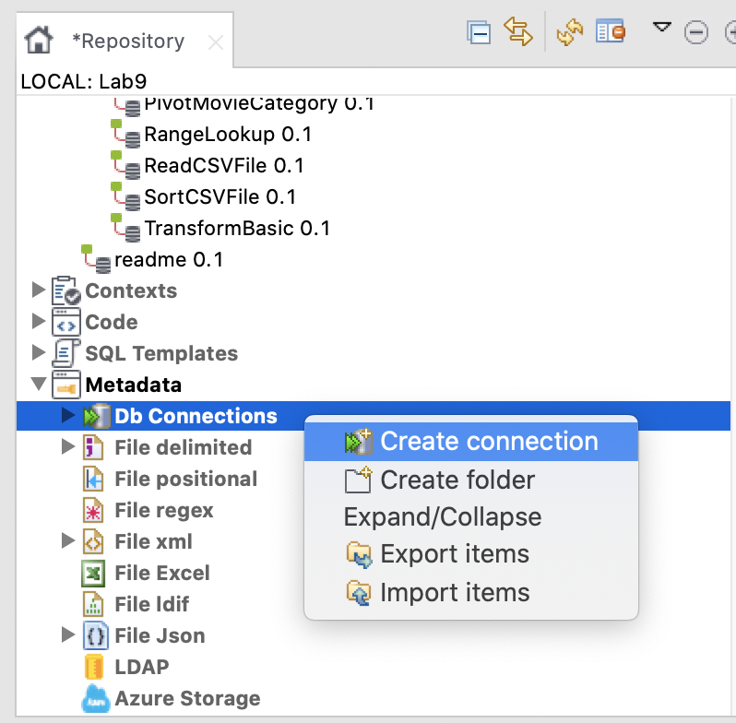
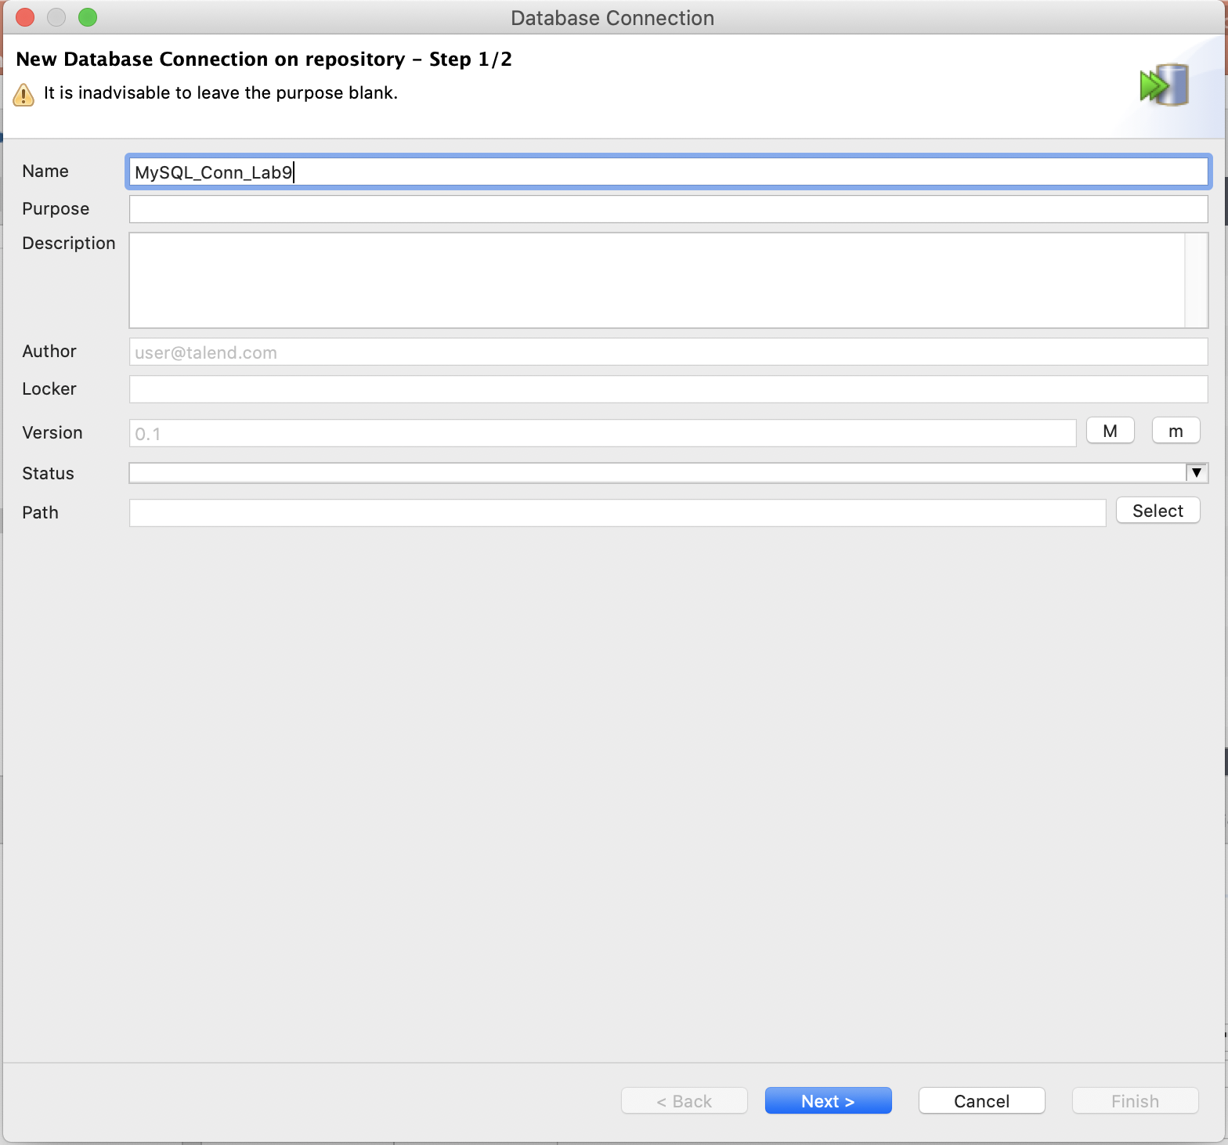
1.1 Create Metadata for DB Connection (1)
Task1
DB Connection name = “MySQL_Conn_movie”

Slide 27
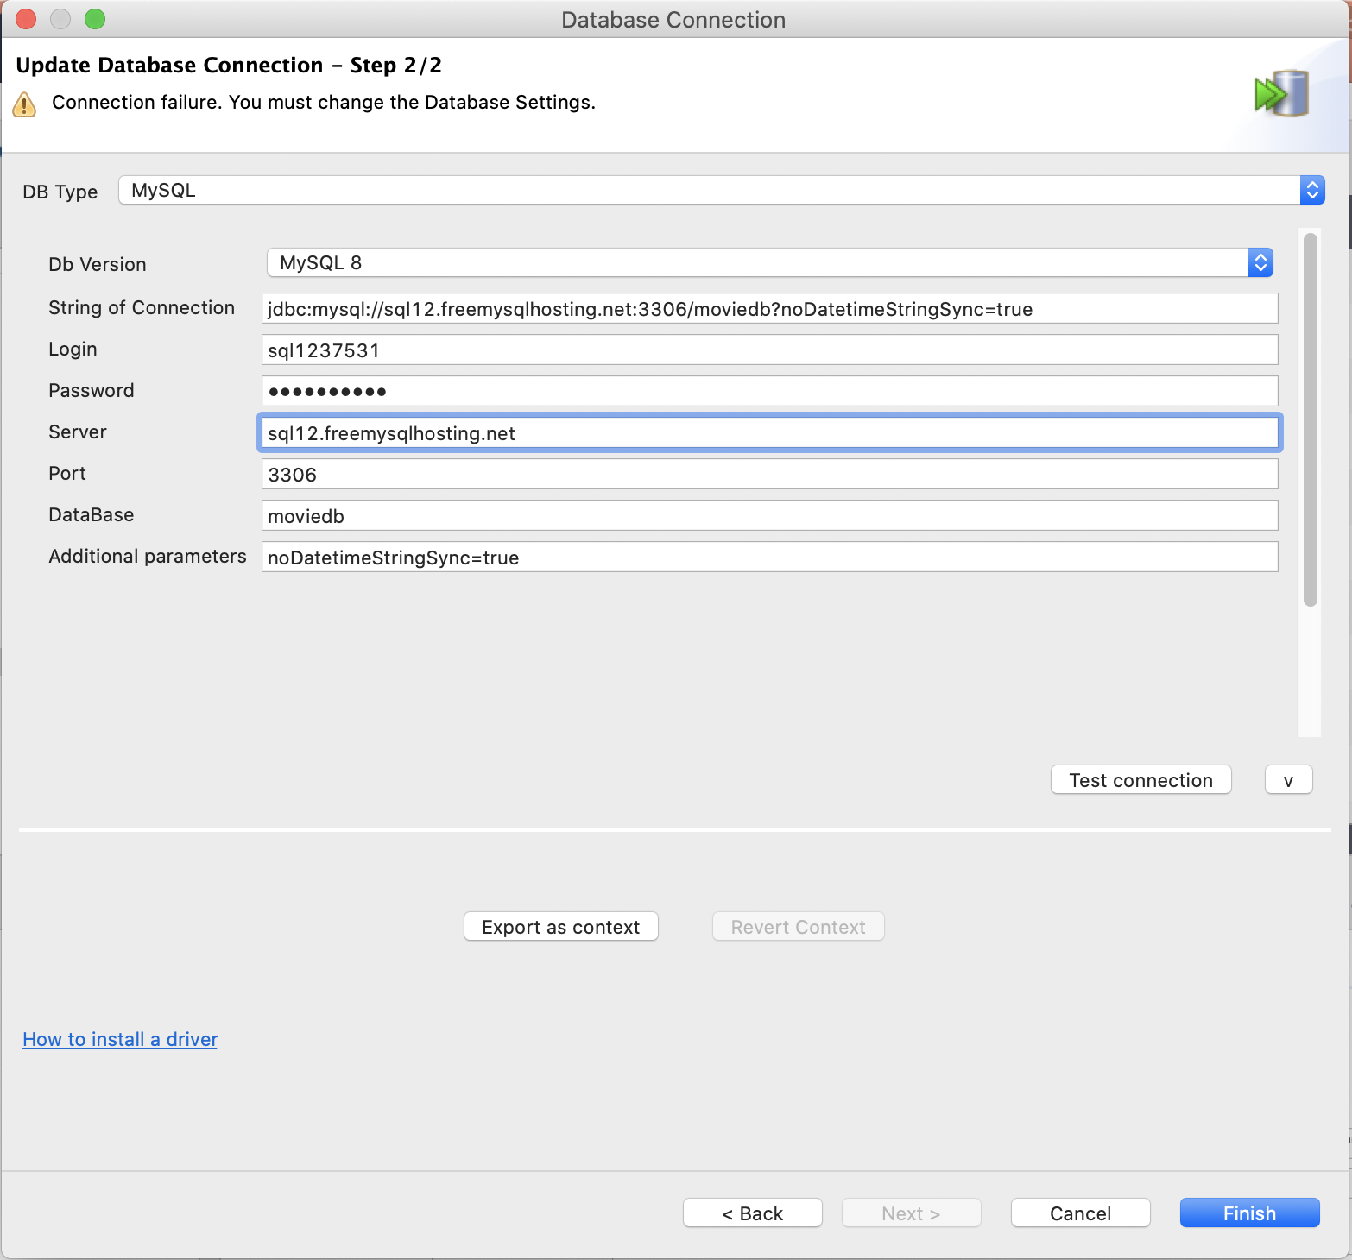
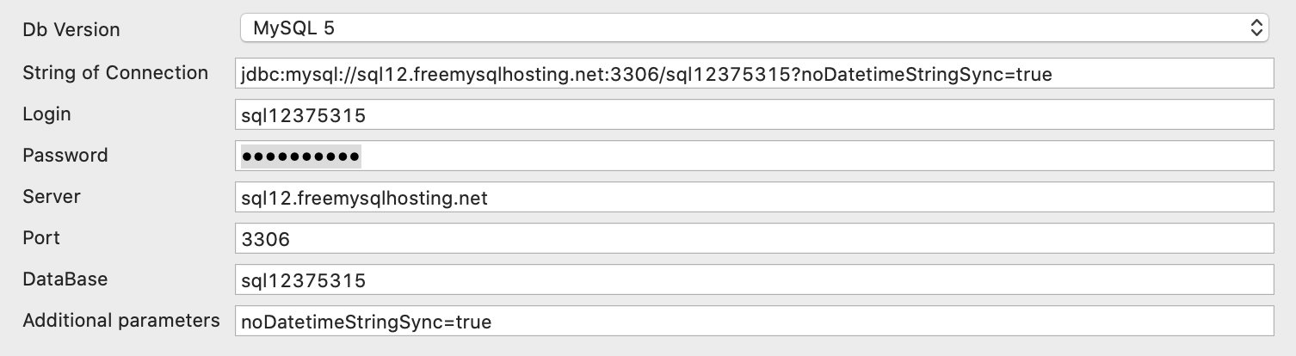
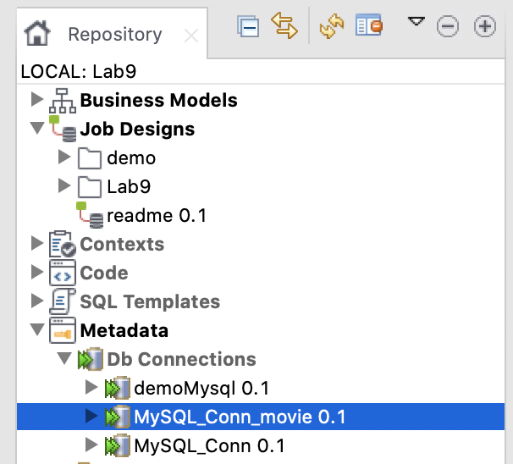
1.1 Create Metadata for DB Connection (2)
Task1
Server: sql12.freemysqlhosting.net
DB Name: sql12375315
Username: sql12375315
Password: mIejQH4MPw
Port number: 3306

Slide 28
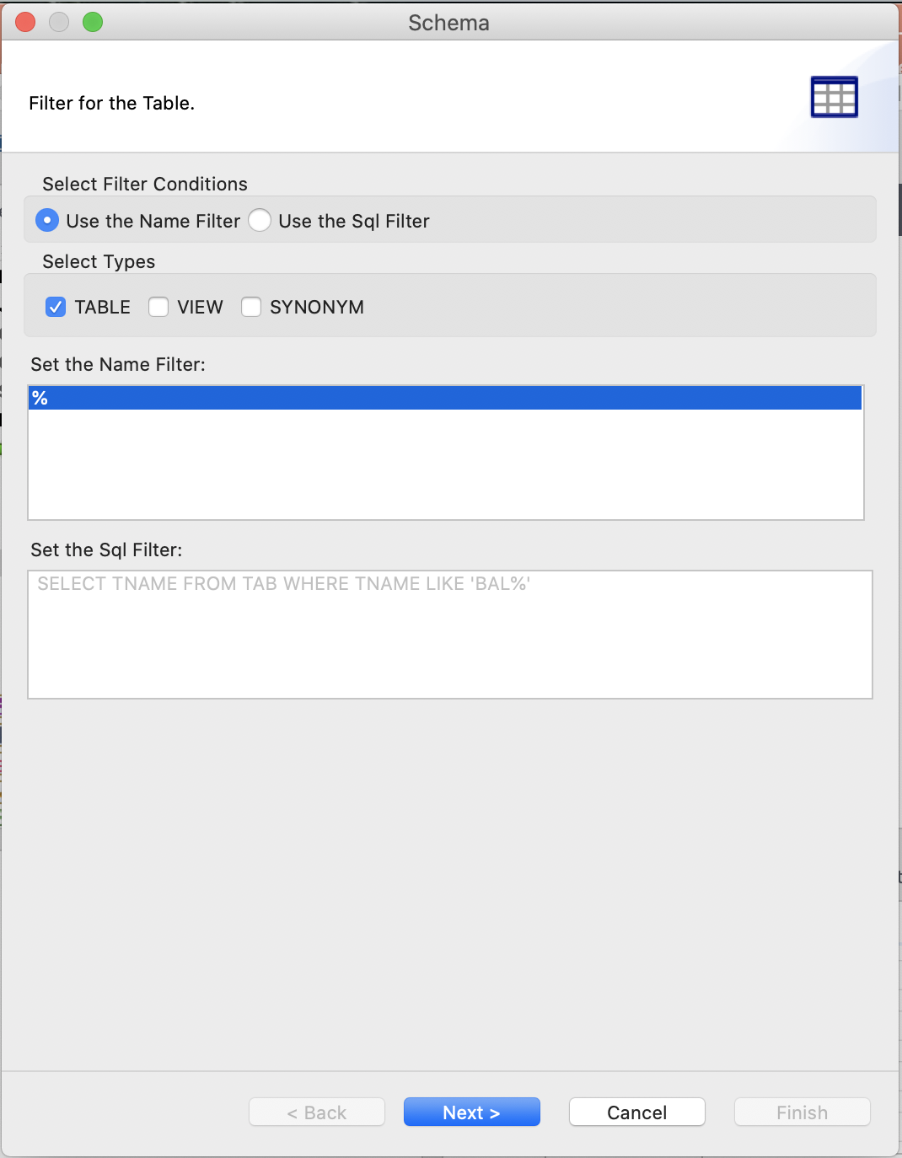
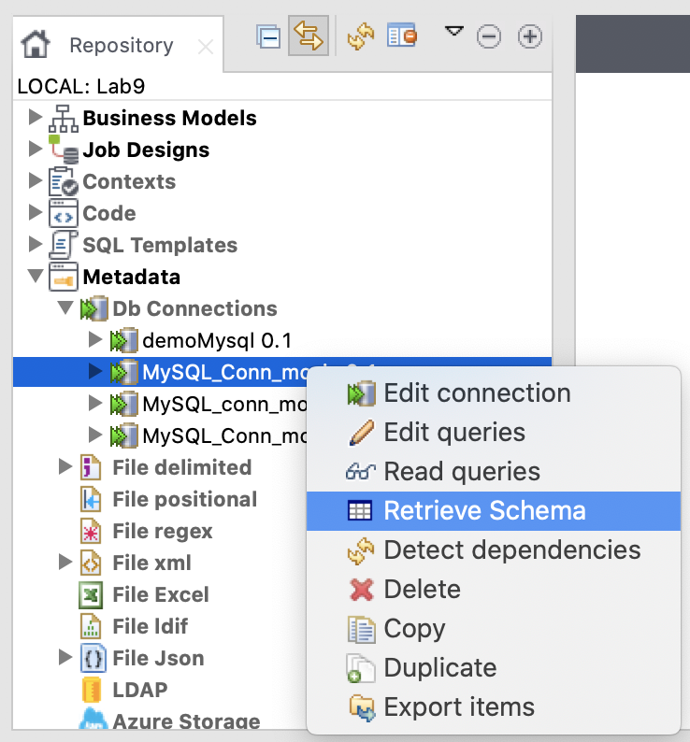
1.1 Create Metadata for DB Connection (3)
Task1

Slide 29
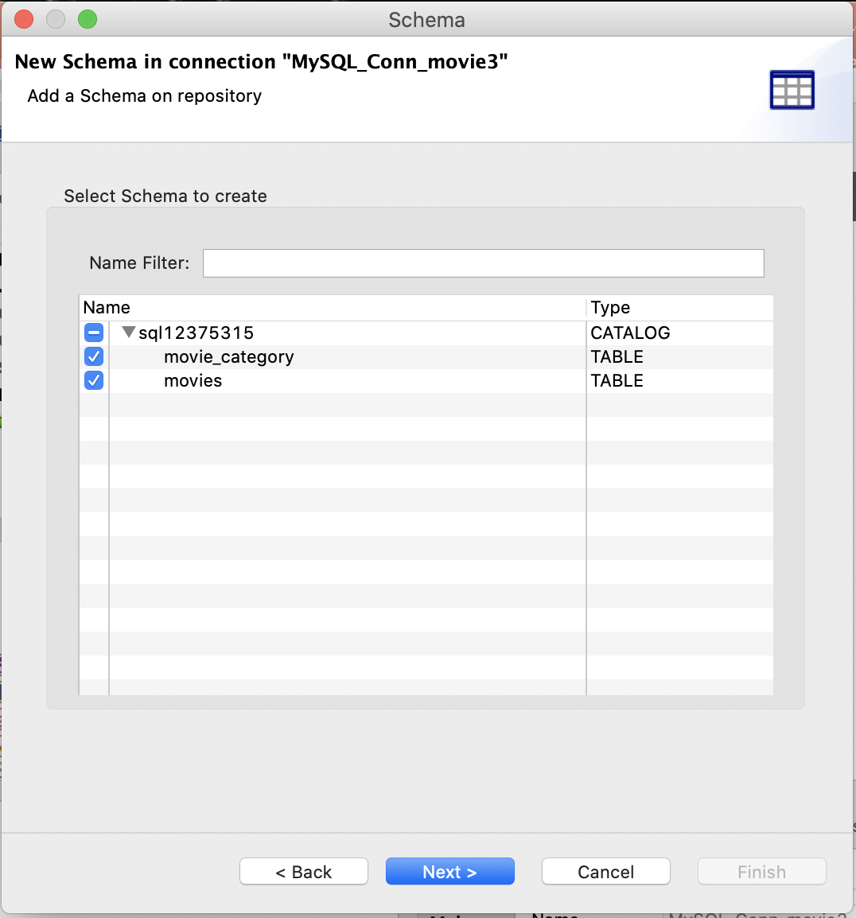
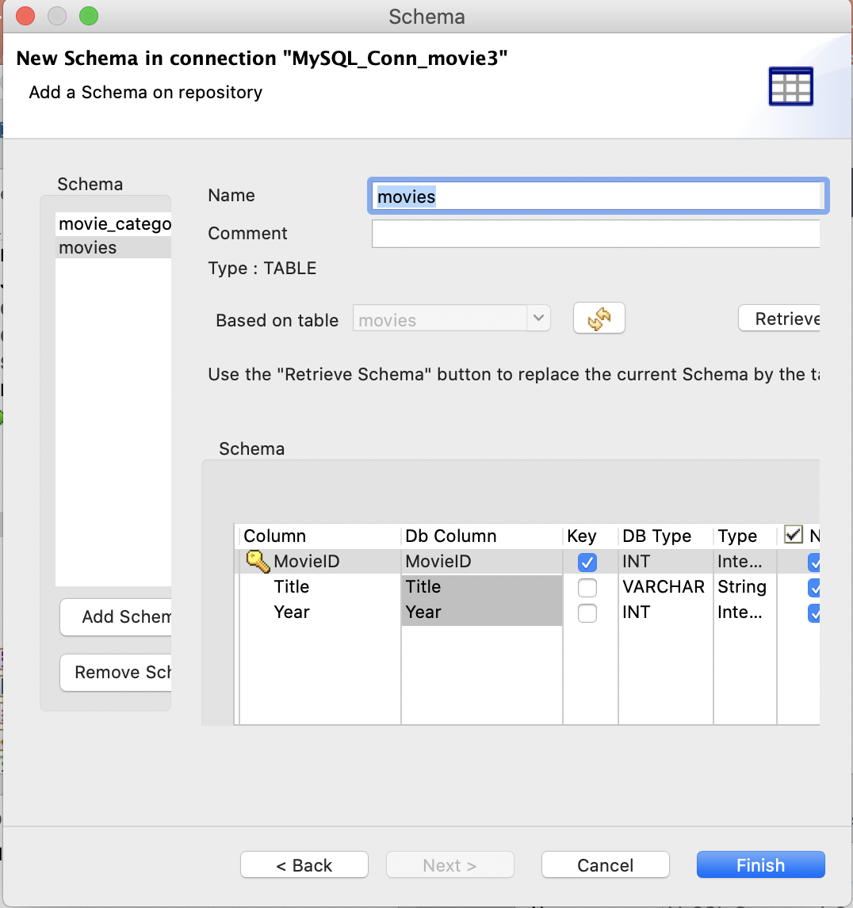
1.1 Create Metadata for DB Connection (4)
Task1

Slide 30
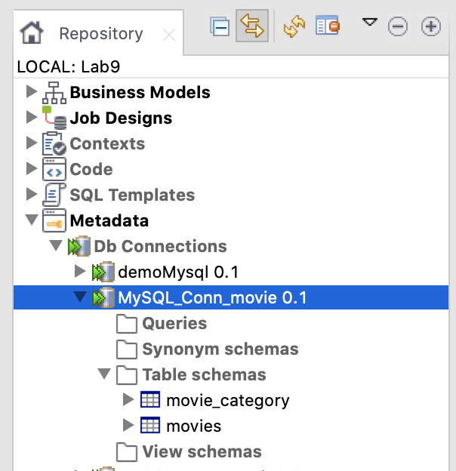
1.1 Create Metadata for DB Connection (5)
Task1
Output of Metadata of DB Connection

Slide 31
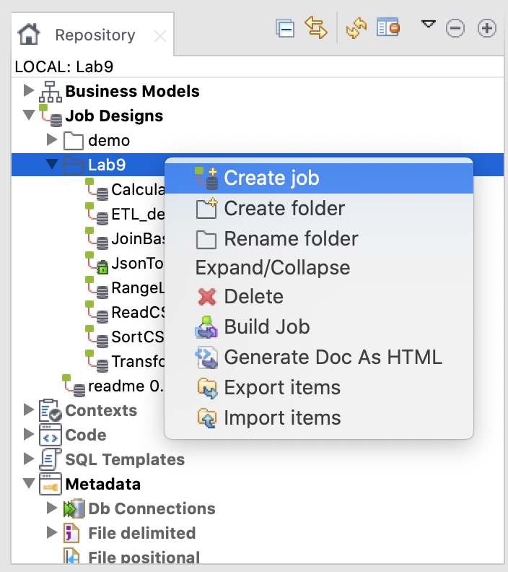
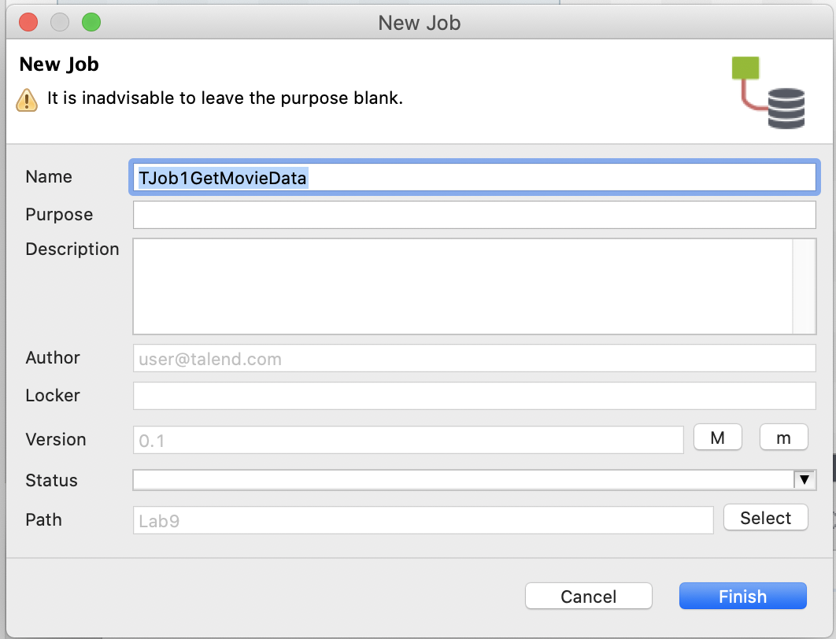
1.2 Create TJob#1: get movie data from RDB and convert data to CSV file (1)
Task1

Slide 32
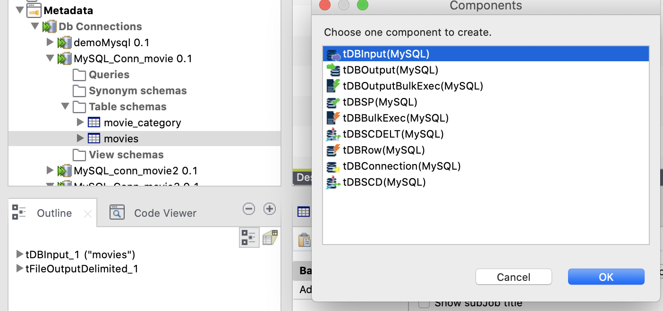
1.2 Create TJob#1: get movie data from RDB and convert data to CSV file (2)
Task1
Drag Metadata of table “movies” under “MySQL_Conn_movie” to Design Workspace

Slide 33
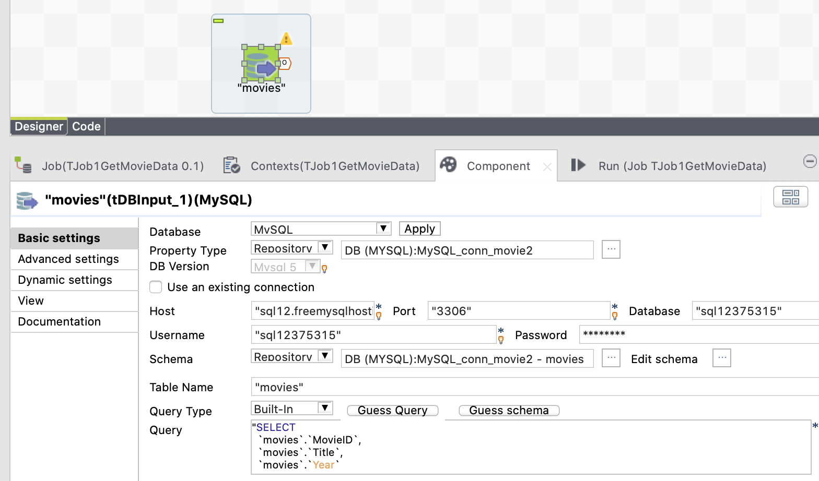
1.2 Create TJob#1: get movie data from RDB and convert data to CSV file (2)
Task1

Slide 34
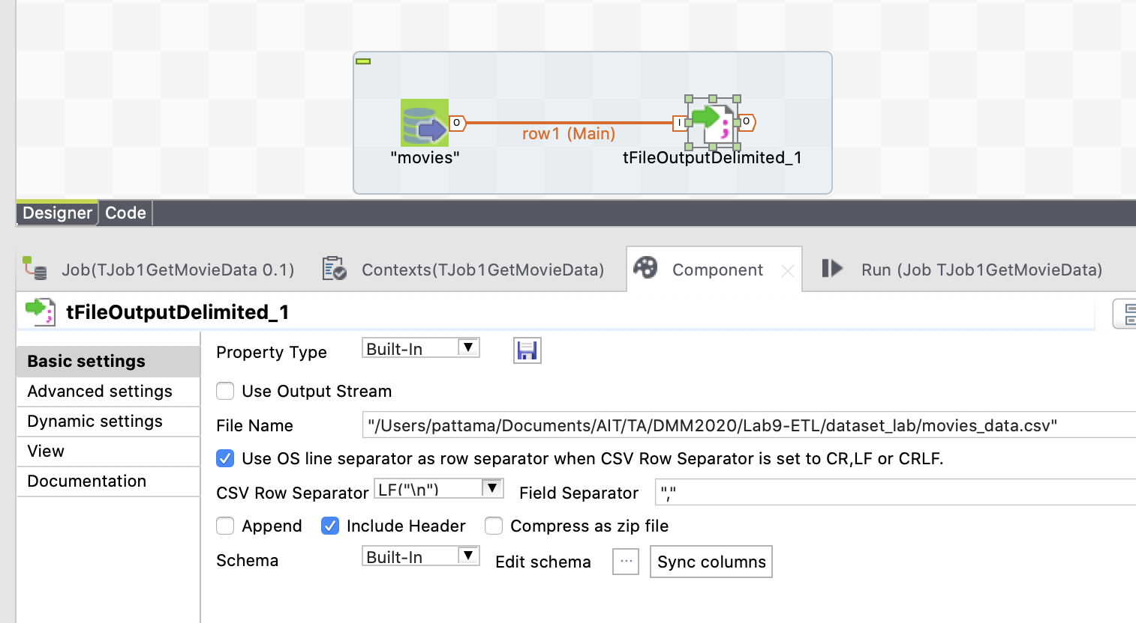
1.2 Create TJob#1: get movie data from RDB and convert data to CSV file (3)
Task1
Basic settings
Notes:
Add “tFileOutputDelimited” component and link

Slide 35
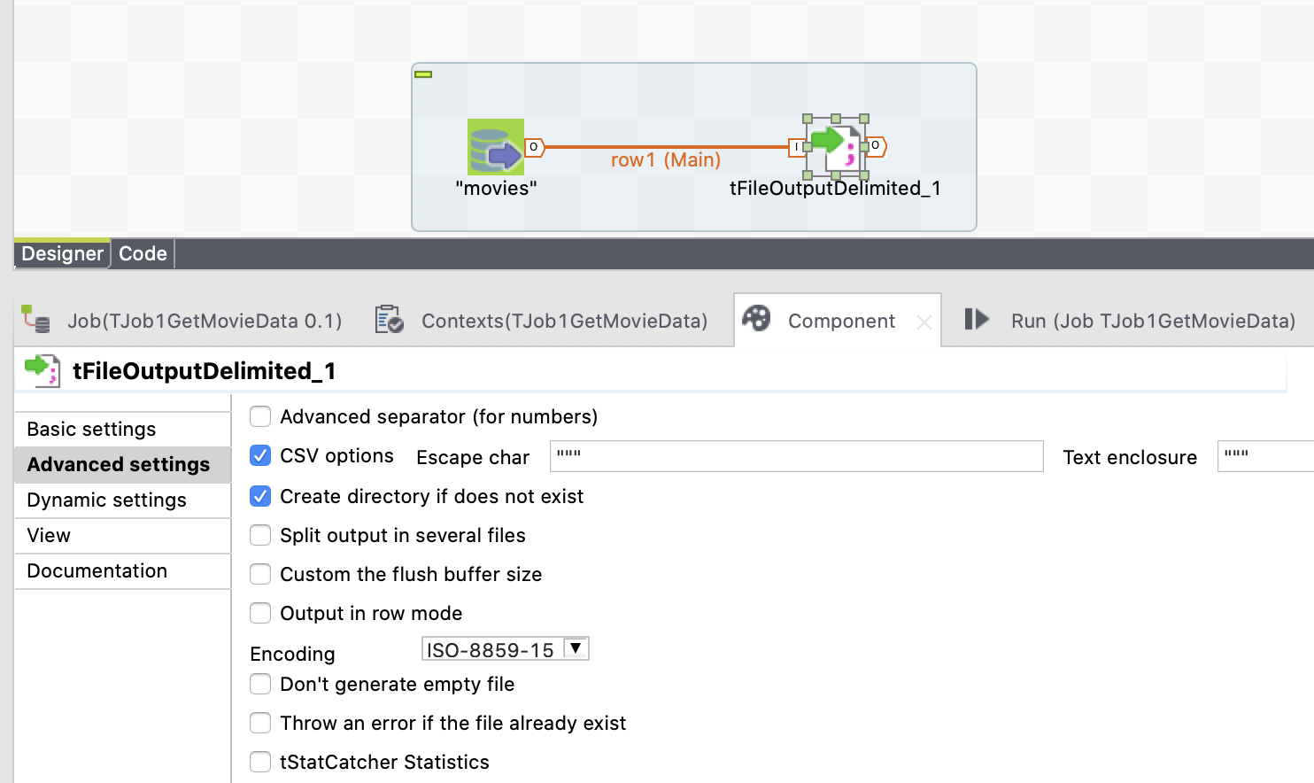
1.2 Create TJob#1: get movie data from RDB and convert data to CSV file (4)
Task1
Advanced settings
Uncheck to allow replace the existing file
Notes:
Add “tFileOutputDelimited” component and link

Slide 36
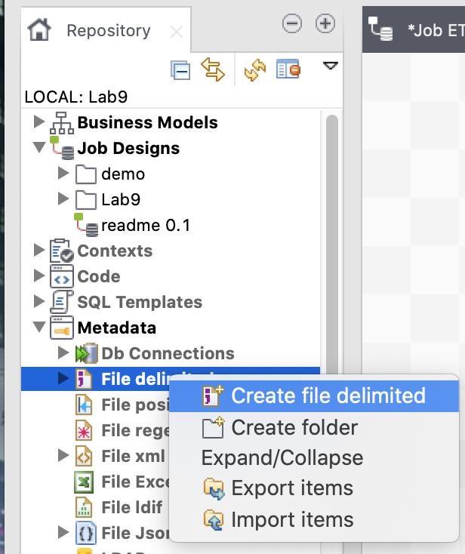
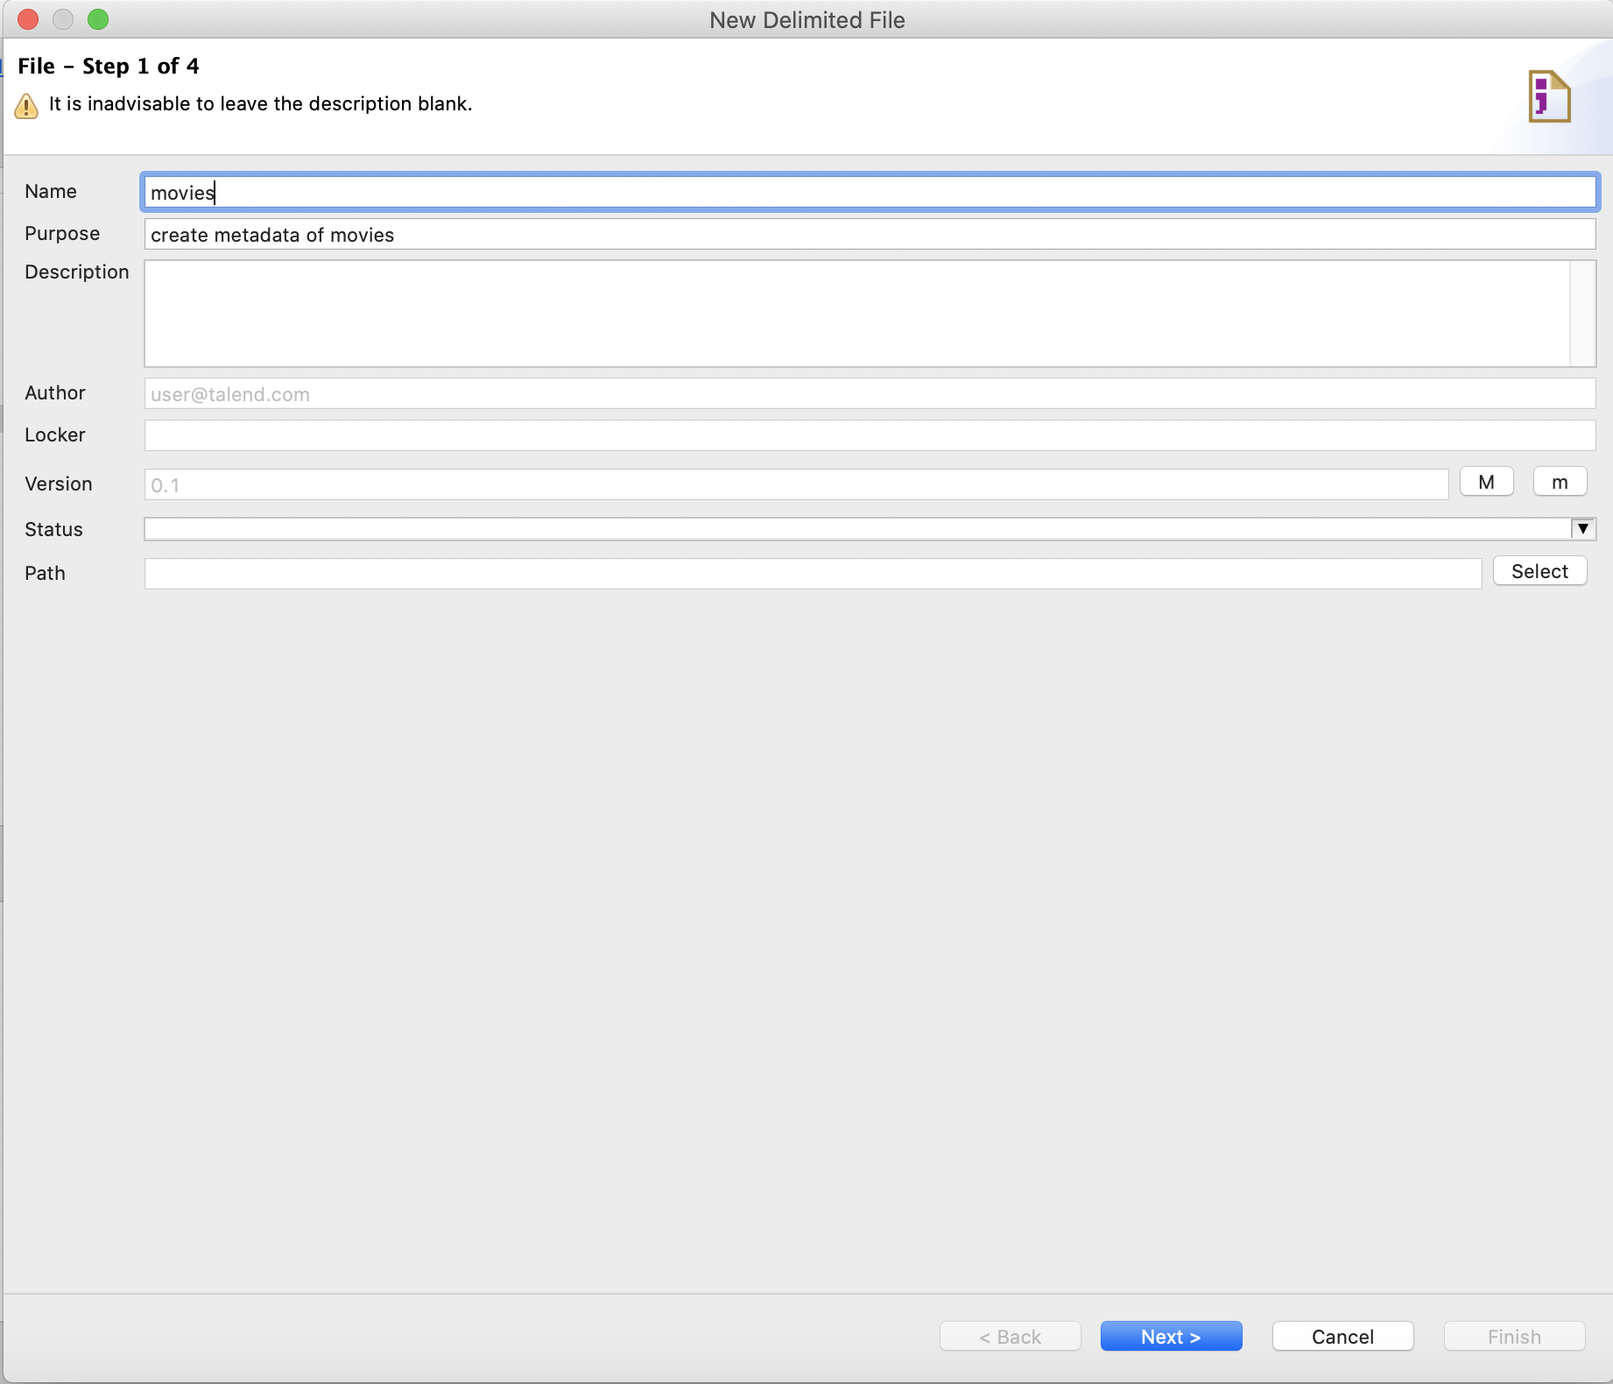
1.3 Create CSV Metadata for Movies (1)
Task1

Slide 37
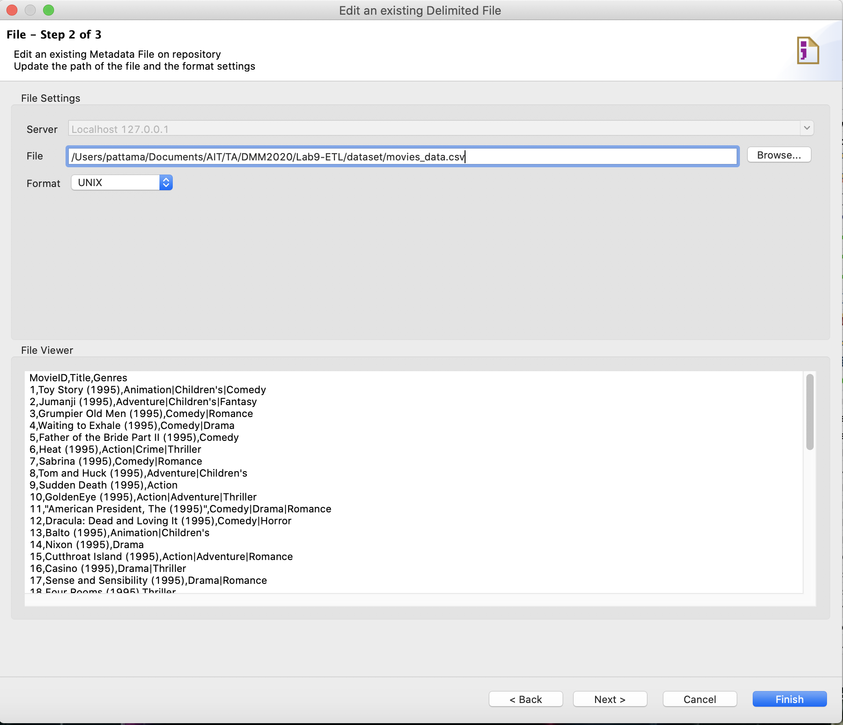
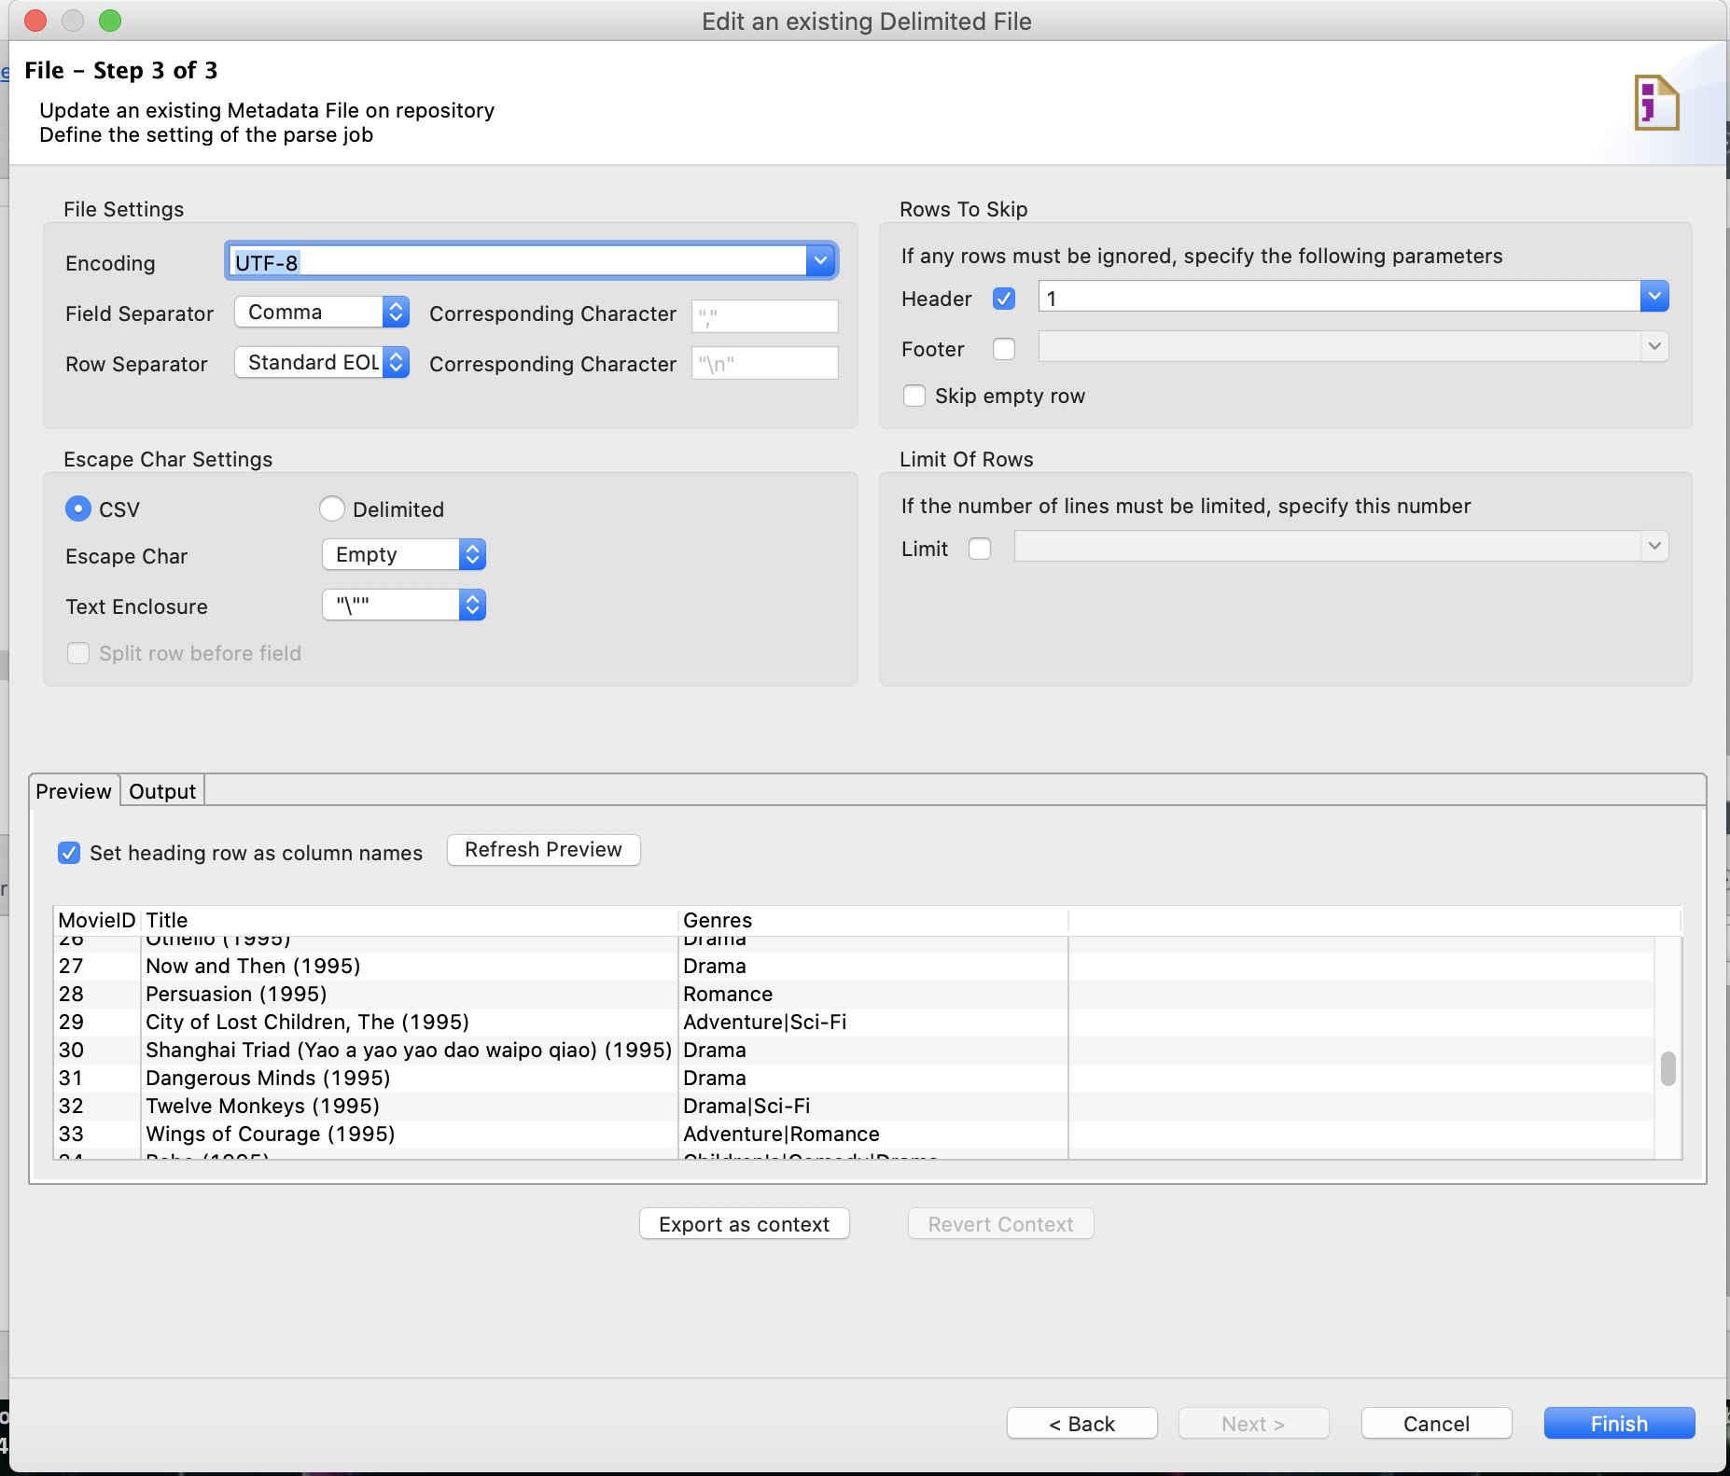
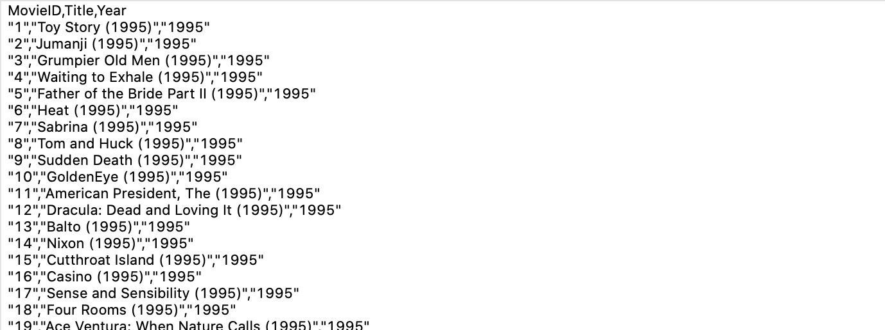
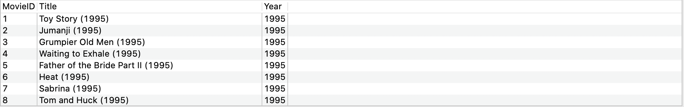
1.3 Create CSV Metadata for Movies (2)
Task1

Slide 38
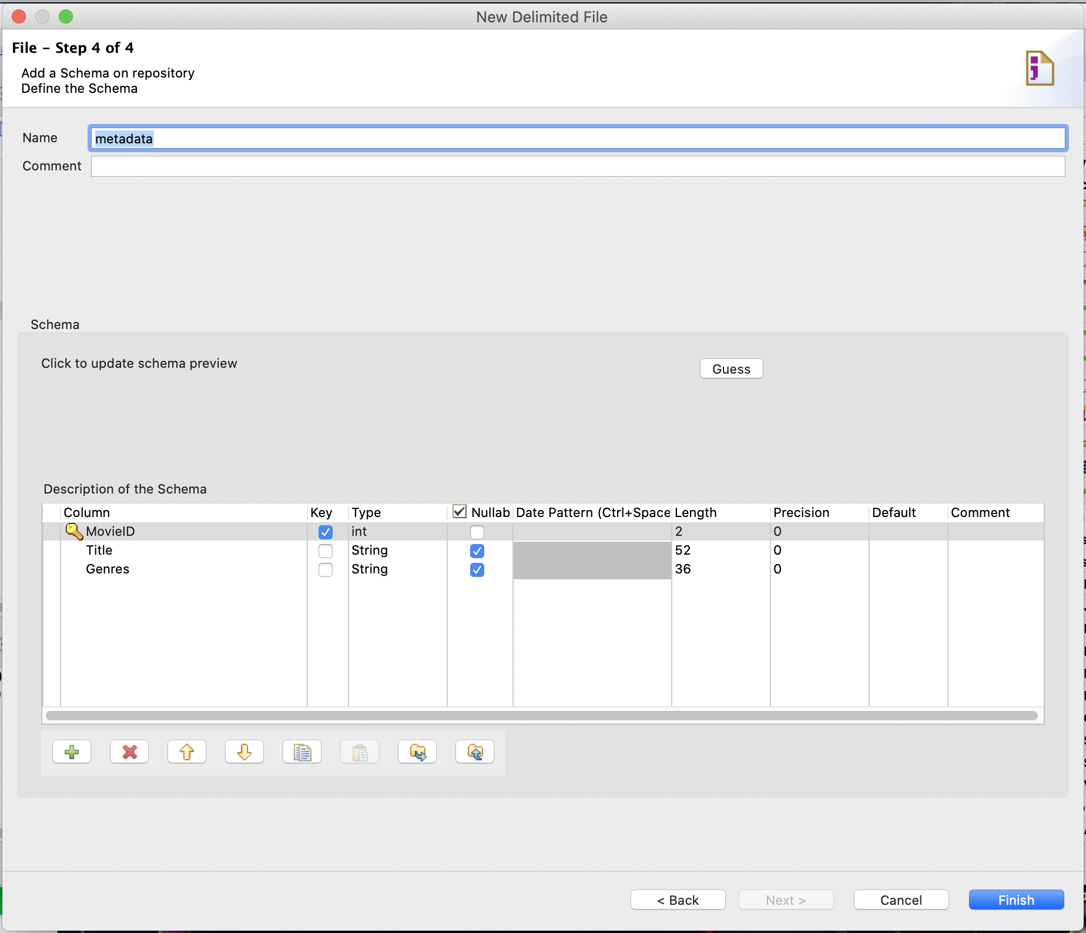
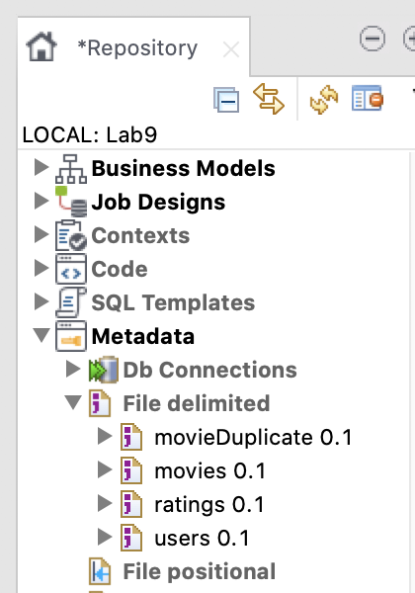
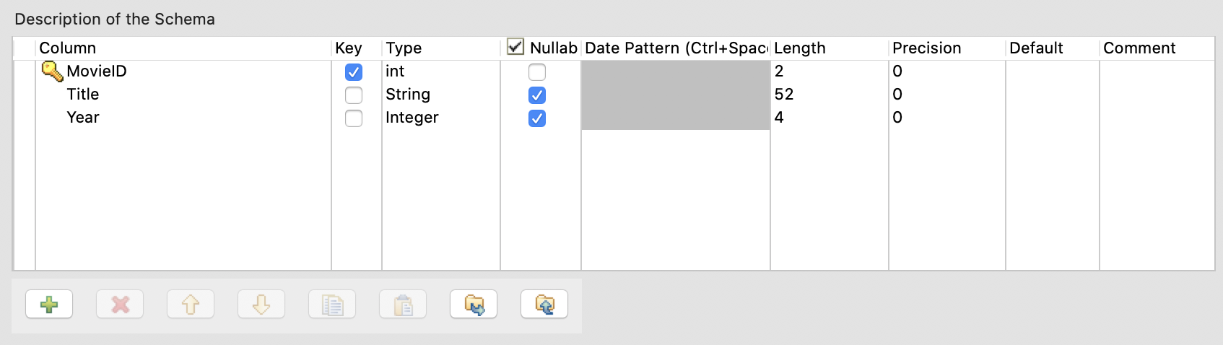
1.3 Create CSV Metadata for Movies (3)
Task1

Slide 39
Output of Task1
Metadata of DB Connection “MySQL_Conn_movie”
Metadata of File delimited “movies”

Slide 40
Movie Rating Prediction
Talend
Input
ETL Process
Talend
Step1: get movie data from RDB and convert data to CSV file
Step2: get user profile in CSV format
Step3: get movie rating by users from MongoDB
3.1 export data to JSON file
3.2 convert Json to CSV file
Task1 for step 1
- 1.1 Create Metadata for DB Connection
- 1.2 Create TJob#1
- 1.3 Create Metadata for movie
Movie
movie
movie_category
Extract
Task2 for step 2
- Create Metadata for user profile
Relational Database
User Profile
Task3 for step 3
- 3.1 Create Metadata for movie rating (Json)
- 3.2 Create TJob#2
- 3.3 Create Metadata for movie rating (File Delimited)
Step.4 Prepare data for desired datasets
4.1 Transform movie category data
4.2 Remove Duplicate Records
4.3 Integrate 3 datasets
4.4 Convert birthdate to Age 4.5 Convert Gender to numeric
4.6 Filter age >= 7 and Gender = 1|2
4.7 Merge output of 4.1 and 4.6
CSV File
Transform
Movie Rating by Users
Task4 for step 4.1
- 4.1 Create TJob#3
- 4.2 Create Metadata for movie category
Export to json
MongoDB
Task5 for step 4.2-5
- Create TJob#4
Load
Step.5 Write output CSV files

Slide 41
Task2 for step 2
User Profile
CSV File
Step2: get user profile in CSV format
Task2:
Create Metadata for user profile (File Delimited)

Slide 42
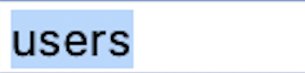
Task2
Create CSV Metadata for User Profile (1)

Slide 43
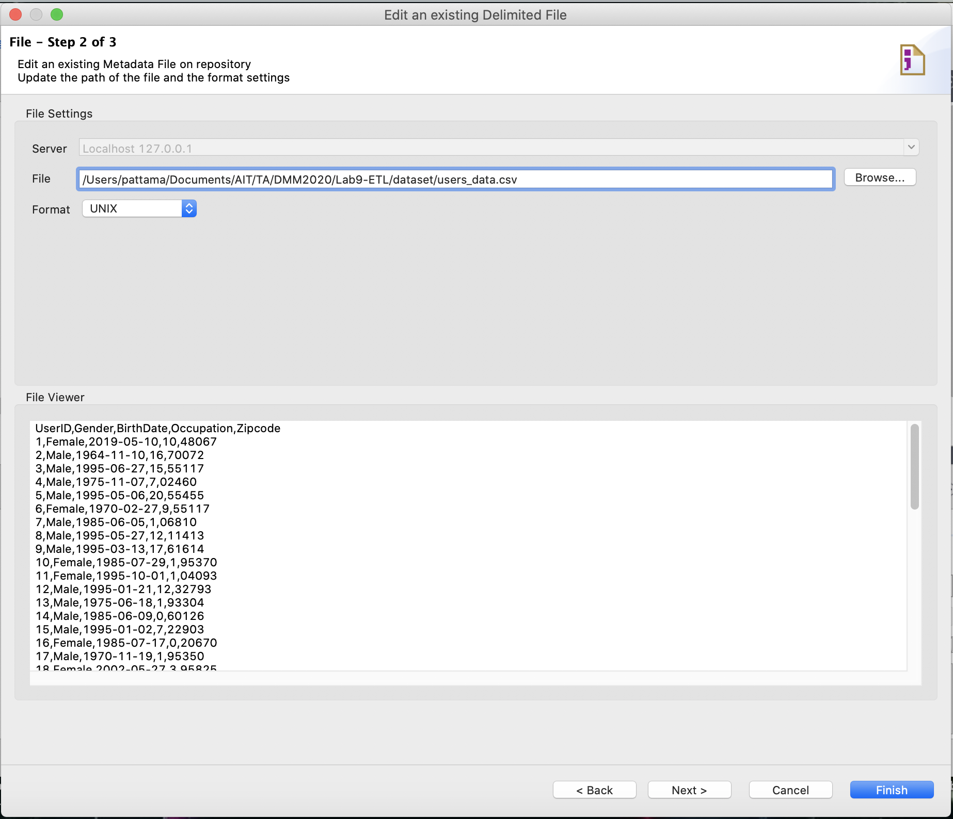
Task2
Create CSV Metadata for User Profile (2)

Slide 44
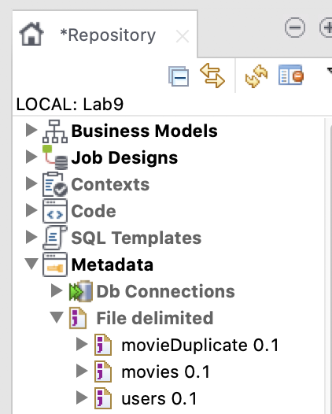
Task2
Create CSV Metadata for User Profile (3)

Slide 45
Output of Task2
Metadata of File delimited “users”

Slide 46
Movie Rating Prediction
Input
ETL Process
Talend
Step1: get movie data from RDB and convert data to CSV file
Step2: get user profile in CSV format
Step3: get movie rating by users from MongoDB
3.1 export data to JSON file
3.2 convert Json to CSV file
Task1 for step 1
- 1.1 Create Metadata for DB Connection
- 1.2 Create TJob#1
- 1.3 Create Metadata for movie
Movie
movie
movie_category
Extract
Task2 for step 2
- Create Metadata for user profile
Relational Database
User Profile
Task3 for step 3
- 3.1 Create Metadata for movie rating (Json)
- 3.2 Create TJob#2
- 3.3 Create Metadata for movie rating (File Delimited)
Step.4 Prepare data for desired datasets
4.1 Transform movie category data
4.2 Remove Duplicate Records
4.3 Integrate 3 datasets
4.4 Convert birthdate to Age 4.5 Convert Gender to numeric
4.6 Filter age >= 7 and Gender = 1|2
4.7 Merge output of 4.1 and 4.6
CSV File
Transform
Movie Rating by Users
Task4 for step 4.1
- 4.1 Create TJob#3
- 4.2 Create Metadata for movie category
Export to json
MongoDB
Task5 for step 4.2-5
- Create TJob#4
Load
Step.5 Write output CSV files

Slide 47
Task3 for step 3
Movie Rating by Users
Export to json
MongoDB
Step3: get movie rating by users from MongoDB
Task3:
- Export data from MongoDB to JSON file
- Convert Json to CSV file 3.1 Create Metadata for movie rating (Json) 3.2 Create TJob#2 3.3 Create Metadata for movie rating (File Delimited)
Atlas MongoDB
Talend
Notes:
3.1 export data to JSON file
3.2 convert Json to CSV file

Slide 48
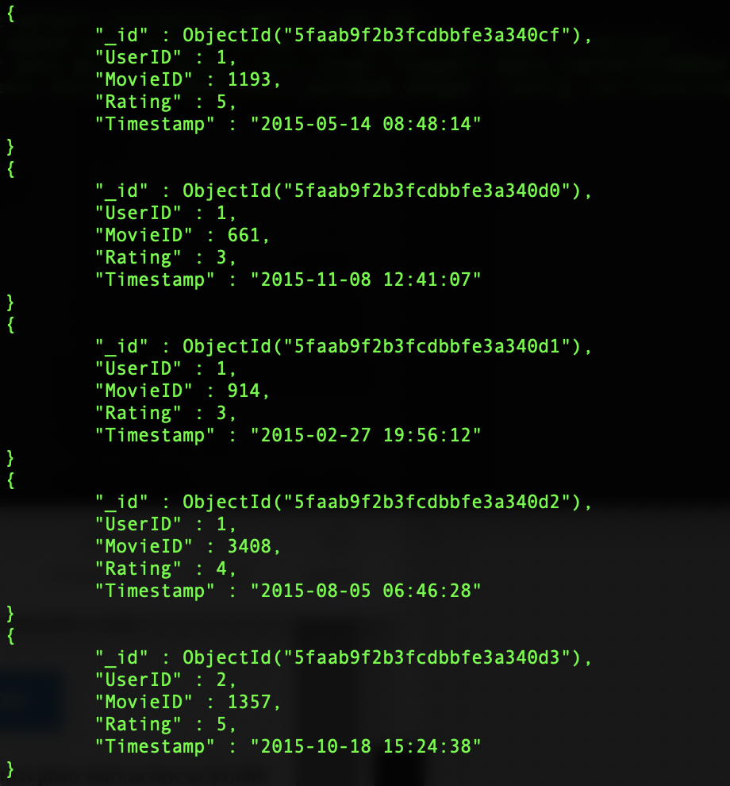
Task3
Export data from MongoDB to JSON file
Atlas MongoDB
movie rating collection in MongoDB
Notes:
Mongo เอา BirthDate ออก

Slide 49
Task3
Export data from MongoDB to JSON file
Export Data from MongoDB to JSONArray via Terminal
Export Data from MongoDB to JSONArray via MongoCompass
URL: https://youtu.be/L6usQ1KbSRs
Example: mongoexport --uri="mongodb://localhost:27017/dmm2020" --collection=ratings --jsonArray --out=/Users/pattama/Documents/AIT/TA/DMM2020/Lab9-ETL/datasets/ratings.json
Source: https://docs.mongodb.com/manual/reference/program/mongoexport/

Slide 50
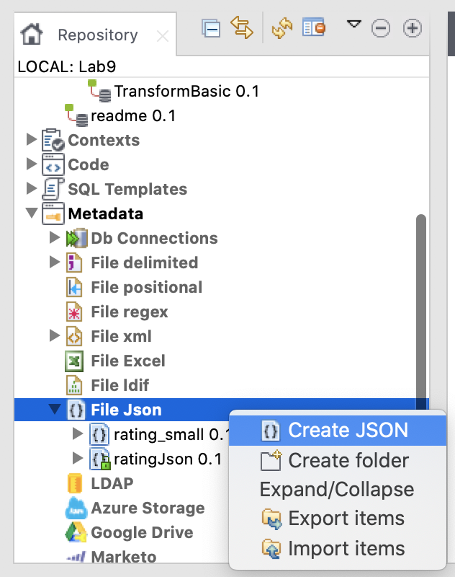
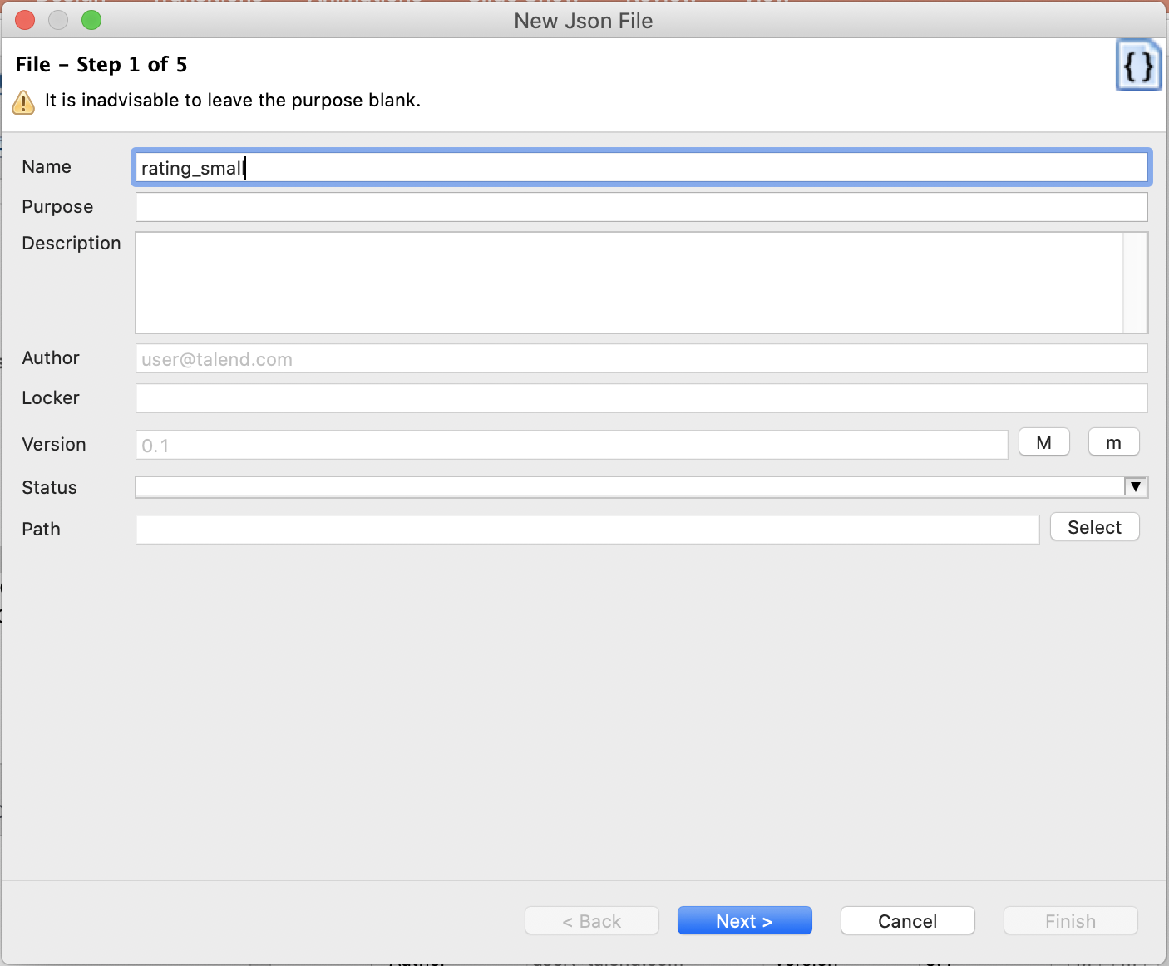
Task3
3.1 Create Metadata for movie rating (Json) (1)

Slide 51
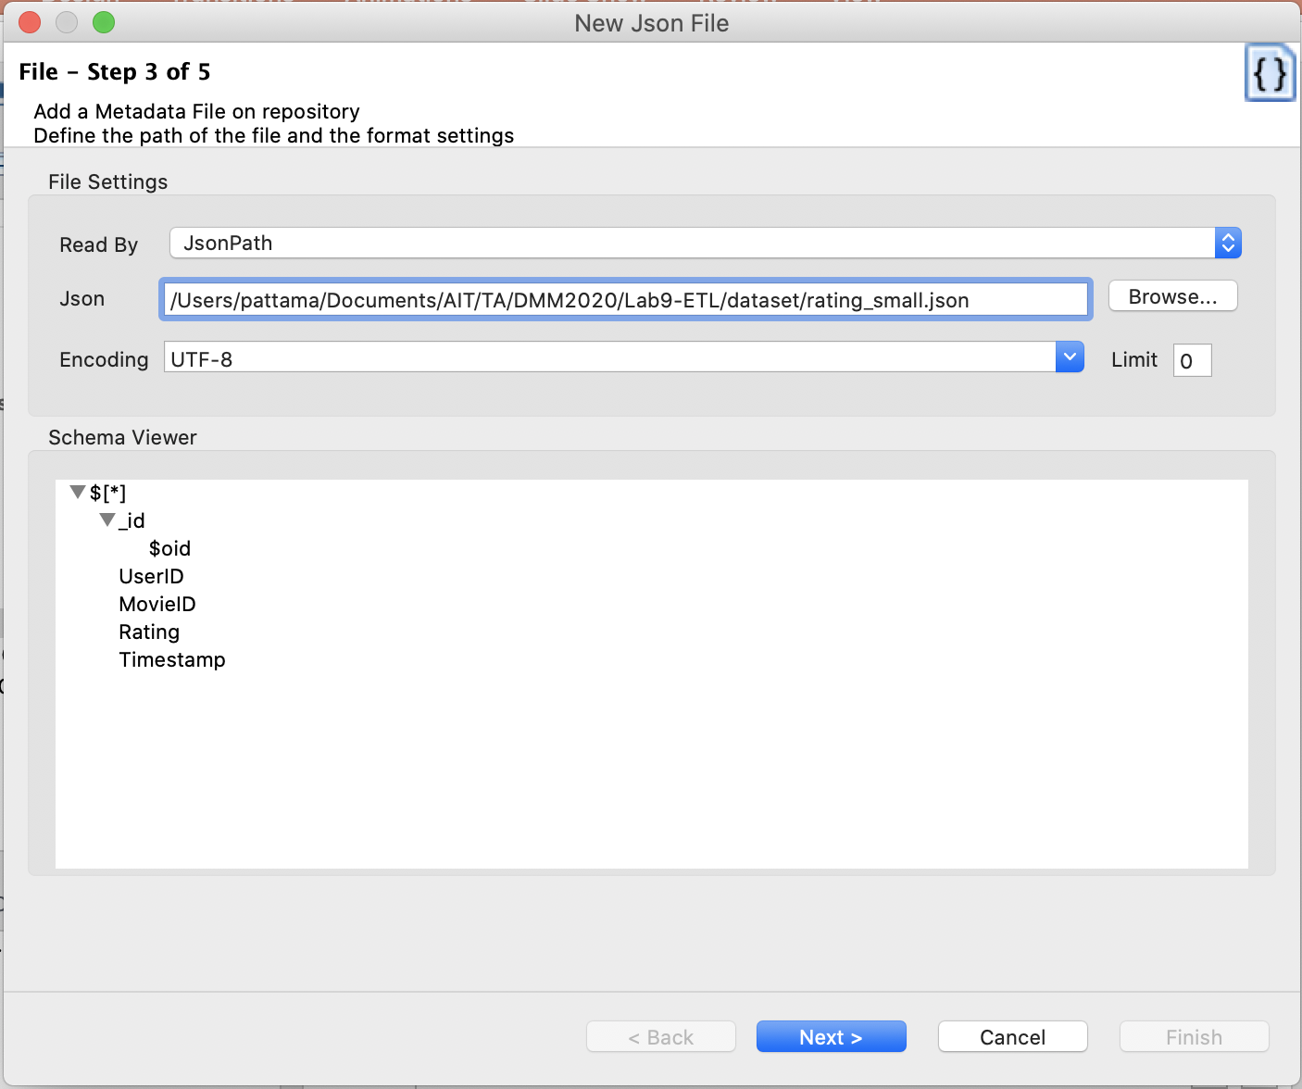
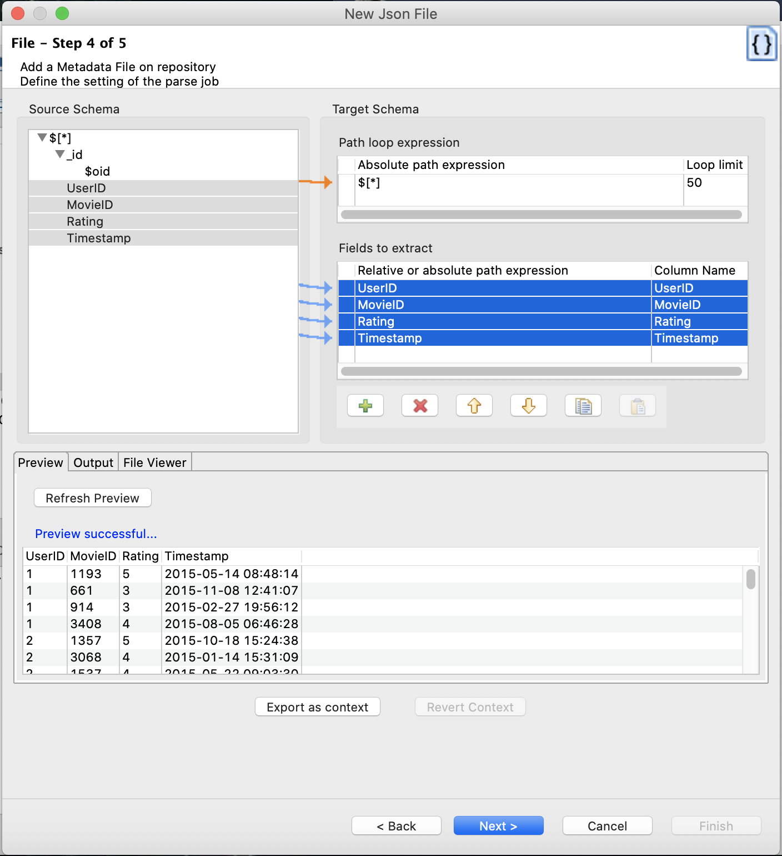
Task3
3.1 Create Metadata for movie rating (Json)(2)

Slide 52
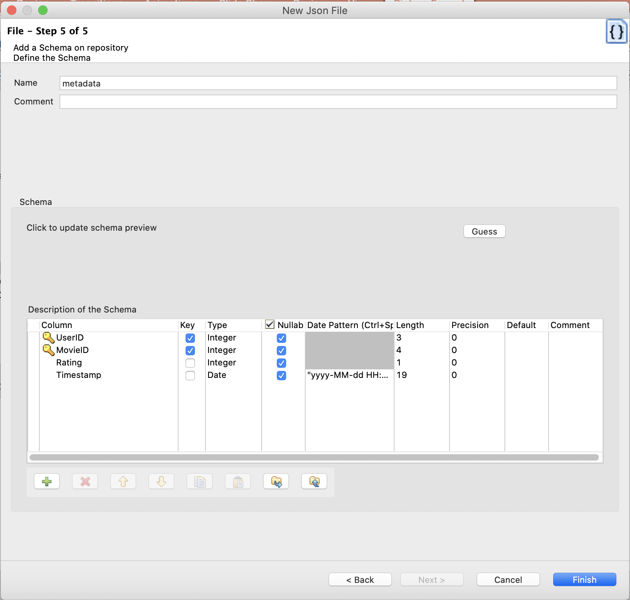

Task3
3.1 Create Metadata for movie rating (Json)(3)
Date pattern = “yyyy-MM-dd HH:mm:ss”

Slide 53

Task3
3.2 Create TJob#2: Convert Json to CSV File
Json Metadata (tInputFileJSON)
ratings.csv

Slide 54

Task3
3.2 Create TJob#2: Convert Json to CSV File
Purpose : Creating a Job to extract json data and convert to CSV file.
Components: tFileInputJson , tFileOutputDelimited

Slide 55

Task3
3.2 Create TJob#2: Convert Json to CSV File (1)

Slide 56


Task3
3.2 Create TJob#2: Convert Json to CSV File (2)
Drag ratings_json to “design workspace” area and click “OK”

Slide 57


Task3
3.2 Create TJob#2: Convert Json to CSV File (3)

Slide 58

Task3
3.3 Create Metadata for movie rating (File Delimited)(1)

Slide 59


Task3
3.3 Create Metadata for movie rating (File Delimited)(2)

Slide 60

Task3
3.3 Create Metadata for movie rating (File Delimited)(3)
Date pattern = “yyyy-MM-dd HH:mm:ss”

Slide 61
Output of Task3
Metadata of File Delimited “ratings”

Slide 62



The Results from Extraction Process
Movies
Users
Ratings
File Delimited Metadata

Slide 63
Part 2

Slide 64
Extraction Process in Part1 (Recap)
Movie
movie
movie_category
Relational Database
movies metadata
Part2
User Profile
Transform & Load Process
CSV File
users metadata
Movie Rating by Users
Export to json
ratings metadata
MongoDB

Slide 65
ETL Process
Extract
Transform
Load
Cleaning
Filtering
Joining
Spliting
…
Image source: https://www.flaticon.com
Notes:
Icons made by <a href="https://www.flaticon.com/authors/freepik" title="Freepik">Freepik</a> from <a href="https://www.flaticon.com/" title="Flaticon"> www.flaticon.com</a>

Slide 66
Movie Rating Prediction
Input
ETL Process
Talend
Step1: get movie data from RDB and convert data to CSV file
Step2: get user profile in CSV format
Step3: get movie rating by users from MongoDB
3.1 export data to JSON file
3.2 convert Json to CSV file
Task1 for step 1
- 1.1 Create Metadata for DB Connection
- 1.2 Create TJob#1
- 1.3 Create Metadata for movie
Movie
movie
movie_category
Extract
Task2 for step 2
- Create Metadata for user profile
Relational Database
User Profile
Task3 for step 3
- 3.1 Create Metadata for movie rating (Json)
- 3.2 Create TJob#2
- 3.3 Create Metadata for movie rating (File Delimited)
Step.4 Prepare data for desired datasets
4.1 Transform movie category data
4.2 Remove Duplicate Records
4.3 Integrate 3 datasets
4.4 Convert birthdate to Age 4.5 Convert Gender to numeric
4.6 Filter age >= 7 and Gender = 1|2
4.7 Merge output of 4.1 and 4.6
CSV File
Transform
Movie Rating by Users
Task4 for step 4.1
- 4.1 Create TJob#3
- 4.2 Create Metadata for movie category
Export to json
MongoDB
Task5 for step 4.2-5
- Create TJob#4
Load
Step.5 Write output CSV files

Slide 67
Task4 for step 4.1
Step4.1: Transform movie category data
Task4:
4.1 Create TJob#3: Transform movie category data
4.2 Create Metadata for movie category (File Delimited)
Notes:
3.1 export data to JSON file
3.2 convert Json to CSV file

Slide 68
Desired Output for Prediction
Gender
Age
Occupation
Movie category
Rating

Slide 69

Task4
4.1 Create TJob#3: Transform movie category data
Change movie category to numeric values for prediction model
MovieID | Animation | Children’s | …. | Romance
1 | 1 | 1 | … | 0
2 | 0 | 1 | … | 0
3 | 0 | 0 | … | 1
Desired output of movie category
movie category table
Notes:
3.1 export data to JSON file
3.2 convert Json to CSV file

Slide 70

Task4
4.1 Create TJob#3: Transform movie category data
Pivot Table:
Add new column named “Values”
Set value = 1 for all records in column “Values”
Pivot “Category” column to header
MovieID | Animation | Children’s | …. | Romance
1 | 1 | 1 | … | 0
2 | 0 | 1 | … | 0
3 | 0 | 0 | … | 1
movie category table
Notes:
3.1 export data to JSON file
3.2 convert Json to CSV file

Slide 71

Task4
4.1 Create TJob#3: Transform movie category data
Purpose : Transform movie category data for prediction movel
Components: tDBInput(MySQL) , tmap, tPivotToColumnsDelimited

Slide 72

Task4
4.1 Create TJob#3: Transform movie category data

Slide 73


Task4
4.1 Create TJob#3: Transform movie category data
Drag Metadata of table “movie_category” under “MySQL_Conn_movie” to Design Workspace

Slide 74

Task4
4.1 Create TJob#3: Transform movie category data
tMap Component
get data from one or more sources
transforms data
sends the transformed data to one or more destinations.
Double click at tMap component

Slide 75

Task4
4.1 Create TJob#3: Transform movie category data
Set value = 1 for all records in column “Values”
2
Set value = 1 for all
records in column “Values”
1
Add column “Values”
Notes:
3.1 export data to JSON file
3.2 convert Json to CSV file

Slide 76

Task4
4.1 Create TJob#3: Transform movie category data
Add tLogRow to check output
Example Output:
MovieID
Category
Values
Example Output
Notes:
3.1 export data to JSON file
3.2 convert Json to CSV file

Slide 77

Task4
4.1 Create TJob#3: Transform movie category data
Pivot column: Category
Aggregation column: Values
Aggregation function: count
Group by: MovieID
Notes:
3.1 export data to JSON file
3.2 convert Json to CSV file

Slide 78

Task4
4.1 Create TJob#3: Transform movie category data
Output after pivot column
Notes:
3.1 export data to JSON file
3.2 convert Json to CSV file

Slide 79

Task4
4.2 Create Metadata for movie category (File Delimited) (1)

Slide 80


Task4
4.2 Create Metadata for movie category (File Delimited) (2)

Slide 81


Task4
4.2 Create Metadata for movie category (File Delimited) (3)

Slide 82
Output of Task4
Metadata of File Delimited “pivot_movie_category”
Using this metadata in Tjob#4 !!!

Slide 83
Movie Rating Prediction
Input
ETL Process
Talend
Step1: get movie data from RDB and convert data to CSV file
Step2: get user profile in CSV format
Step3: get movie rating by users from MongoDB
3.1 export data to JSON file
3.2 convert Json to CSV file
Task1 for step 1
- 1.1 Create Metadata for DB Connection
- 1.2 Create TJob#1
- 1.3 Create Metadata for movie
Movie
movie
movie_category
Extract
Task2 for step 2
- Create Metadata for user profile
Relational Database
User Profile
Task3 for step 3
- 3.1 Create Metadata for movie rating (Json)
- 3.2 Create TJob#2
- 3.3 Create Metadata for movie rating (File Delimited)
Step.4 Prepare data for desired datasets
4.1 Transform movie category data
4.2 Remove Duplicate Records
4.3 Integrate 3 datasets
4.4 Convert birthdate to Age 4.5 Convert Gender to numeric
4.6 Filter age >= 7 and Gender = 1|2
4.7 Merge output of 4.1 and 4.6
CSV File
Transform
Movie Rating by Users
Task4 for step 4.1
- 4.1 Create TJob#3
- 4.2 Create Metadata for movie category
Export to json
MongoDB
Task5 for step 4.2-5
- Create TJob#4
Load
Step.5 Write output CSV files

Slide 84
Task5 for step 4.2-5
Step4.2-5: Prepare dataset for desired datasets
Task5:
Create TJob#4: Prepare dataset for desired datasets (Main Job)
Notes:
3.1 export data to JSON file
3.2 convert Json to CSV file

Slide 85

Task5
Create TJob#4: Prepare dataset for desired datasets (Main Job)
Purpose : Prepare dataset for desired datasets Components: tFileInputDelimited, tUniqRow, tMap, tFileOutputDelimited_1
tUniqRow - Compares entries and sorts out duplicate entries from the input flow.
tMap
get data from one or more sources
transforms data
sends the transformed data to one or more destinations.

Slide 86

Task5
Create TJob#4: Prepare dataset for desired datasets

Slide 87




Task5
Create TJob#4: Prepare dataset for desired datasets
Step 4.2 Remove Duplicate Records

Slide 88


Task5
Create TJob#4: Prepare dataset for desired datasets
Step 4.3 Integrate 3 datasets
Join tables

Slide 89

Task5
Create TJob#4: Prepare dataset for desired datasets
Output Table
“Joinedtable”
Step 4.3 Integrate 3 datasets
Input Tables
Set join model = Inner join
Notes:
Basic Mapping + Create table output

Slide 90

Task5
Create TJob#4: Prepare dataset for desired datasets
Step 4.3 Integrate 3 datasets
Output of step 4.3 is “Joinedtable”

Slide 91
Task5
Create TJob#4: Prepare dataset for desired datasets
Step 4.4: Convert birthdate to Age
Step 4.5: Convert Gender to numeric
Transform Data
- Convert birth date to age (numeric values)
- Convert Gender to numeric values (Male=1,Female=2)
Filtering Data
- Filter age more than 7 years
Users

Slide 92

Task5
Create TJob#4: Prepare dataset for desired datasets
Transform Data:
Step 4.4: Convert birthdate to Age
Step 4.5: Convert Gender to numeric
Step 4.6: Filter age >= 7 and Gender = 1|2
Join tables
Transform

Slide 93

Task5
Create TJob#4: Prepare dataset for desired datasets
Input Table
Filter Data
Create Variables
Notes:
Transform data
Create new column
Create variable
Filter data

Slide 94


Task5
Create TJob#4: Prepare dataset for desired datasets
Create variable named “Gender2”
-> set condition to transform Gender
Create variable named “Age”
-> Calculate age
Notes:
Transform data
Create new column
Create variable
Filter data

Slide 95
Task5
Create TJob#4: Prepare dataset for desired datasets
Create Variables
Call java method
Age(int)
TalendDate.diffDateFloor(TalendDate.parseDate("yyyy-MM-dd",TalendDate.formatDate("yyyy-MM-dd", Joinedtable.Timestamp)), Joinedtable.BirthDate,"yyyy")
IF/ELSE Statement
Gender2
(String)
(Joinedtable.Gender.equals("Male"))?1: (Joinedtable.Gender.equals("Female"))?2:0
Filter Data
(Var.Age >= 7) && (Var.Gender2 == 1 || Var.Gender2 == 2)
Notes:
Calling Java Method
TalendDate.diffDateFloor is java method –calculate age by comparing date between birthdate and datetime of rating movie
IF/ELSE Statement
If (Gender. equals("Male"))
return 1
If else(Gender. equals(”Female"))
return 2
else
return 0

Slide 96

Task5
Create TJob#4: Prepare dataset for desired datasets
Add tLogRow to check output
Example Output:
MovieID
UserID
Gender2
Age
Occupation
Rating

Slide 97

Task5
Create TJob#4: Prepare dataset for desired datasets
Step 4.7: Merge output of 4.1 and 4.6
- Add File Delimited Metadata “pivot_movie_category” to merge the output and merge output at tMap_2
- Double click at tMap_2
1
2

Slide 98

Task5
Create TJob#4: Prepare dataset for desired datasets
Output for Prediction Model
Step 4.7: Merge output of 4.1 and 4.6 for Prediction Model

Slide 99

Task5
Create TJob#4: Prepare dataset for desired datasets
Step 4.7: Merge output of 4.1 and 4.6 for Visualization
Output for Visualization

Slide 100
ETL Process
Extract
Transform
Load
Cleaning
Filtering
Joining
Spliting
…
Image source: https://www.flaticon.com
Notes:
Icons made by <a href="https://www.flaticon.com/authors/freepik" title="Freepik">Freepik</a> from <a href="https://www.flaticon.com/" title="Flaticon"> www.flaticon.com</a>

Slide 101

Task5
Create TJob#4: Prepare dataset for desired datasets
Step 5: Write output CSV file for Prediction Model
Output for Prediction Model

Slide 102

Task5
Create TJob#4: Prepare dataset for desired datasets
Step 5: Write output CSV file for Visualization
Output for Visualization

Slide 103
Output of Task5
Dataset for Prediction Model “Movie Rating Prediction ”
Dataset for Visualization

Slide 104

Output of Task5
Output for Prediction Model

Slide 105
Output of Task5
Output for Visualization

Slide 106
References
https://www.talend.com/resources/discovering-talend-studio/
https://www.tutorialspoint.com/talend/index.htm

Slide 107

Thank you.

Slide 108


Tips: Config DB
Drag component
1.Schema – select Repository 2. Click button and select table name
3. Click guess query , then the default query will show in the box
2
1
3

